Slide 1
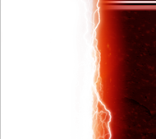
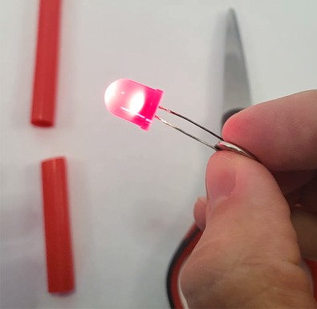
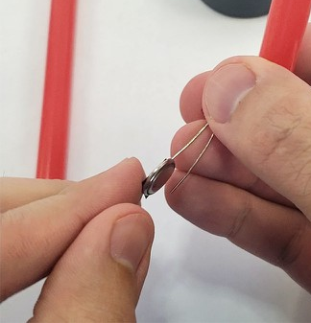

Pinch the LED legs around the battery so it lights up (flip it if it doesn’t).
Tape one LED leg to one side of the battery. Leave a small gap between the other LED leg and the battery so the light only turns on when you squeeze them together.
Gently press the battery and both LED legs into one end of the straw, making sure there is still a gap between the two LED legs. (TIP: use a pencil to help push it in.)
Wrap coloured cellophane around the straw and secure it with tape.
Wrap duct tape or masking tape around the bottom of the straw to make the handle. Squeeze the handle to light it up.
Visual guide step 1:
Visual guide step 2:

