Slide 1

CRANBOURNE EAST
SECONDARY COLLEGE
"Giving every student. every opportunity to exceed their potential by pro,nding a high quality pathway to success.·

Slide 2
NOUN
Science Technician
(sahy-uh-ns tek-nish-uh-n)
A persovi wit\tl tvie skills of tA VlCAvidred professiovis yet t\tle stAltAry of viovie of t\tlevnl

Slide 3
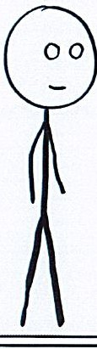
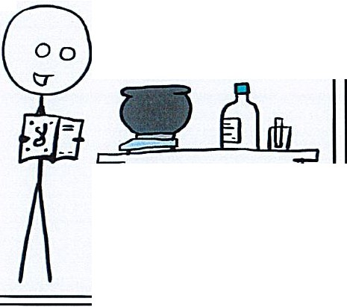
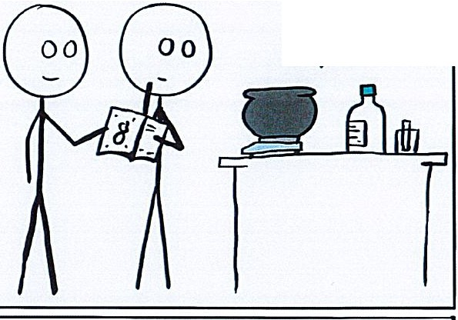
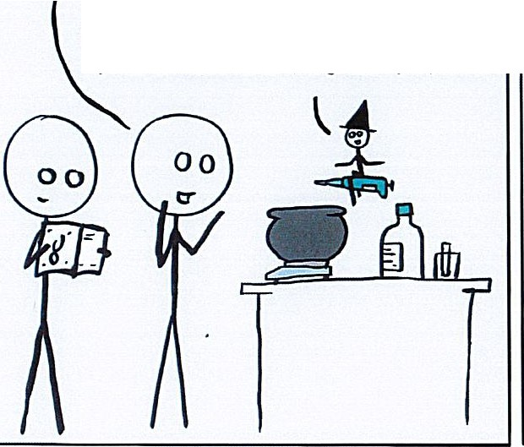
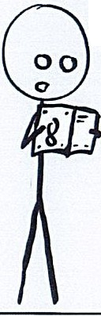
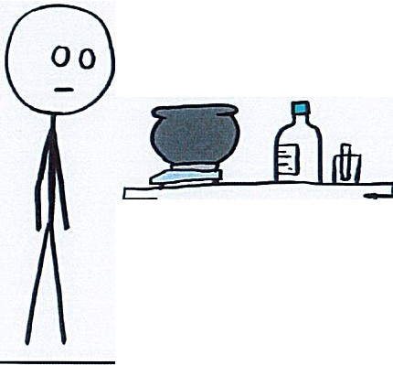

OH LAB \./ITCH PLEASE COME AND HELP MY EXPERIMENT RUN
�DD A DROP Of BUFFER MADE FROM OAT MILK, MUSTARD SEEDS AND THE
l
i
-t
EYELASH OF A PROFESSOR
'1tND THAT \./ILL \./ORK?
No, BUT 11' S GOT JUST AS MUCH CHANCE Of \./,ORKING AS THE GARBAGE YOU RE TRYING
WAIT, THIS SAYS HO\./ TO
YOU N'EEDED THE CHOCOLATE
SUMMON A SARCASTIC \./ITCH
OFFERING TO GET A HELPFUL ONE
J
ERRANTSCIENCE.COM

Slide 4




BENCH SPRAY
RECIPE
2L Water
50ml Handy Andy 25ml Eucalyptus Oil
25ml Peppermint Essence
***Purchase from Coles Oli Woolworths
***Use an empty 2L Distilled water bottle
Label - Bench Spray
ADD above ingredients and shake As the oil settles to the top
shake each time you want to transfer to a spray bottle.
*
*
*
*
Use for benches after dissections Cleaning the sinks
Removes fat from benches and metals Cleans white boards without damaging the surface. (Use a towel)

Slide 5
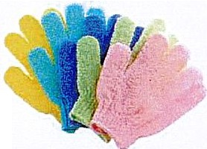

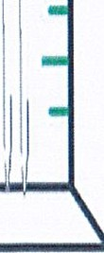
CLEANING
Cleaning dissection equipment -
place in a shallow tray. ADD 1 tbsp citric acid cover with boiling water wait till the water goes cold dry and put away
Cleaning carbonised glassware -
Loofa glove
Available from $2 shop.
Put on your hand and lightly scrub the
base of a beaker or test tube that is blackened
\
\
Cleaning pipettes -
H f H
If you don't have a pipette washer
Stand pipettes in a 1L tall measuring cylinder (about 10cm diameter)
Fill with water to the top,
Put you han•d• over the top and invert to drain the water
repeat at least 3 times.
Stand pipettes upside down to drain and dry on a spike rack
I
I

Slide 6
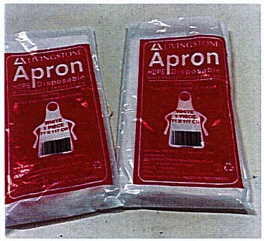
DISSECTIONS
Tray for each dissection instrument. Number how many in the tray
Hardly use scalpels as scissors are safer and easier to use for most pracs.
Chopping board: flexible mat (cut in half)
Stand up container with Dettol to soak instruments coming back from class.
Hand wash bottles are colour coded for each trolley along with a spray bottles for cleanup.
TWO BOTTLES OF EACH
15 classes, number the RAS request as you go, then you can keep track of how many you have done.
Gloves from Coles $8 per 100 box
Aprons - Livingstone $20.85 per 100

Slide 7
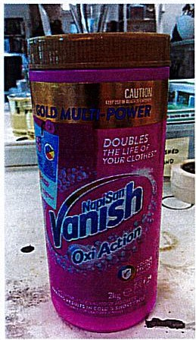
SOAKER
Removes oil fat or food from test tubes and glassware
Sprinkle powder into glassware
ADD boiling water and top up with hot tap water if you need more.
separating funnels. burette taps
test tubes
stained glassware - beakers - rust stains
Soak overnight then rinse and wash

Slide 8
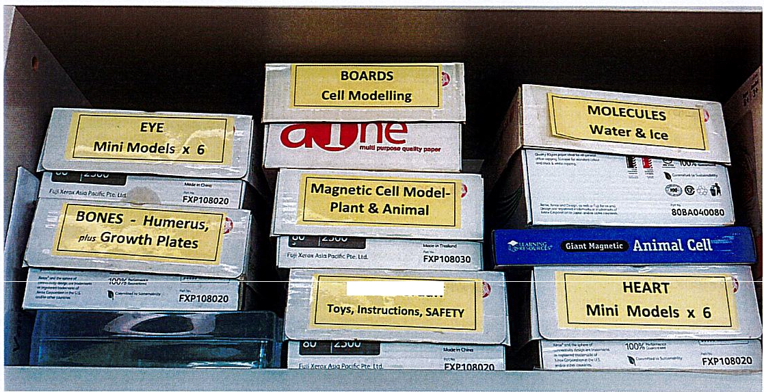
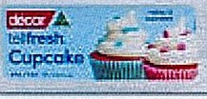
STORAGE
Van de Graaff
Photocopy boxes Plenty of them,
there are new ones everyday They come in two sizes.
And stack easily, A4 x 2 on an A3 box
FREE!!
Some I cut down to fit the equipment and/or space.
Decor cupcake box - $5 Coles (on special)
Use these for storage of class set beakers 12 x 250ml beaker
6 X 500ml beaker 20 x 100ml beakers
Easy stock control
Easy to put a set on a trolley
Don't have to lift glassware individually to move
**
Balances {they stack neatly in the cupboard)

Slide 9
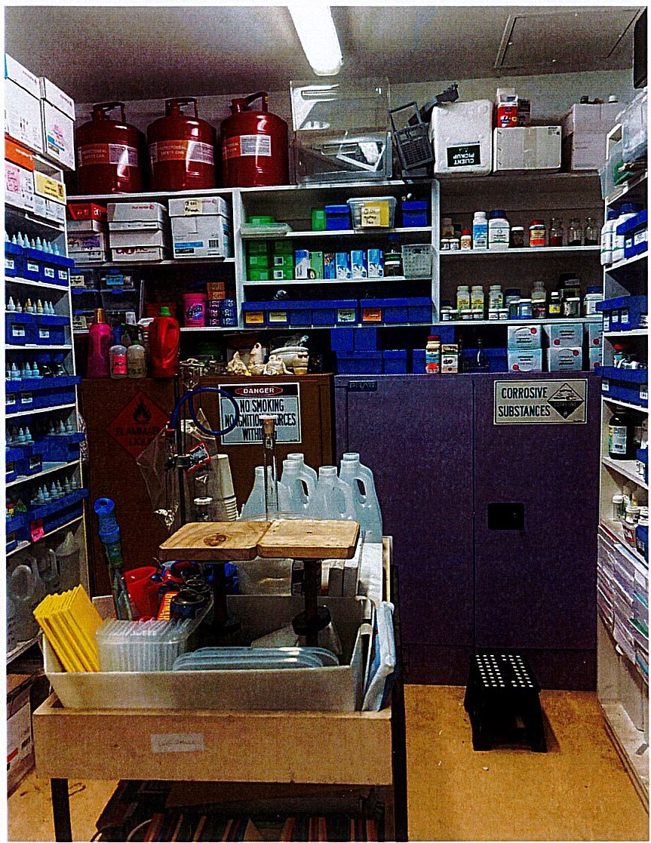
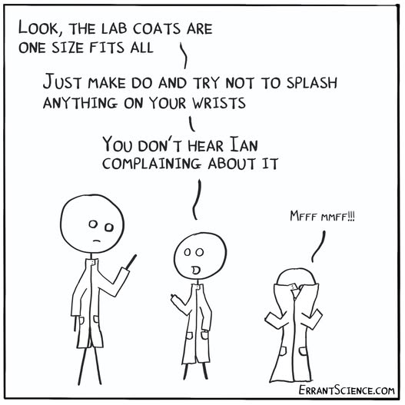
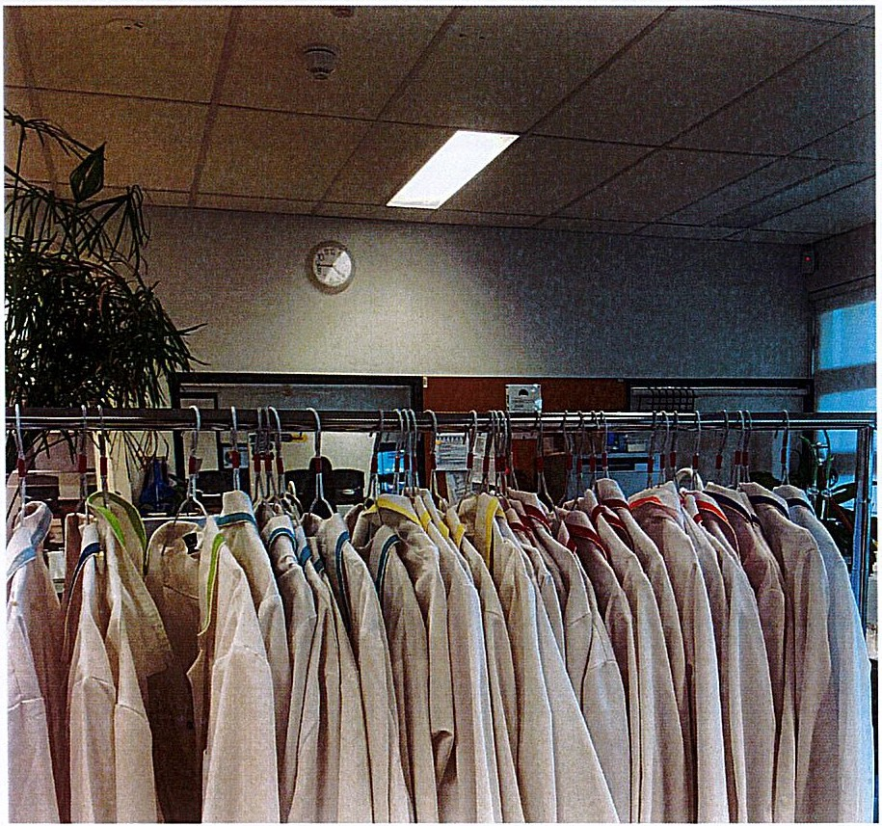
Lab Coat collars are coloured coded for each size.
ie: blue= Large
Students try on at the start of the year and make note of the colour that fits, then they don't have to check tags for size.
Poly cotton bias binding from spotlight straight stitching across the back of the callar.

Slide 10
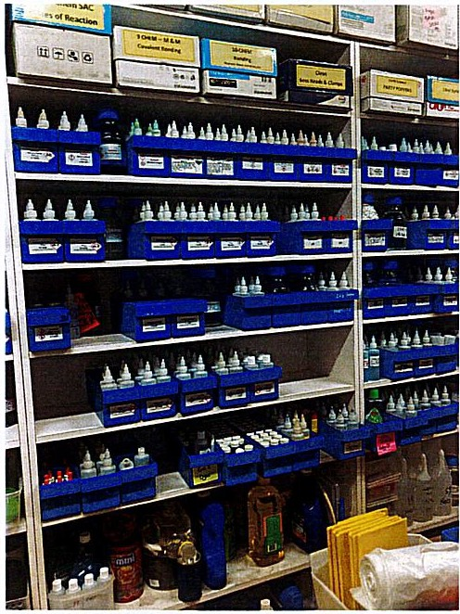
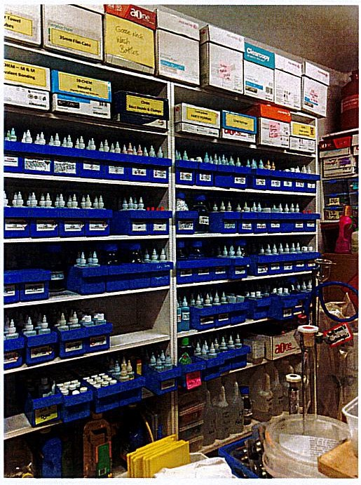
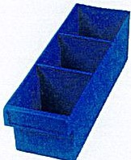
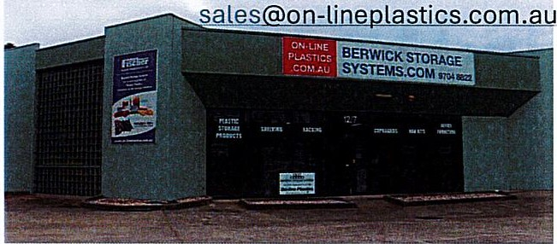
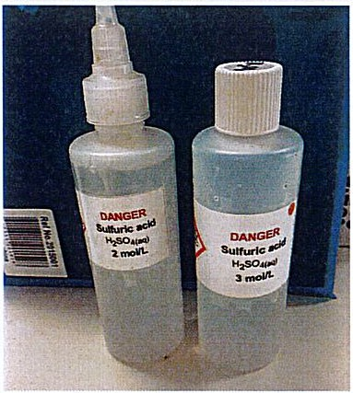
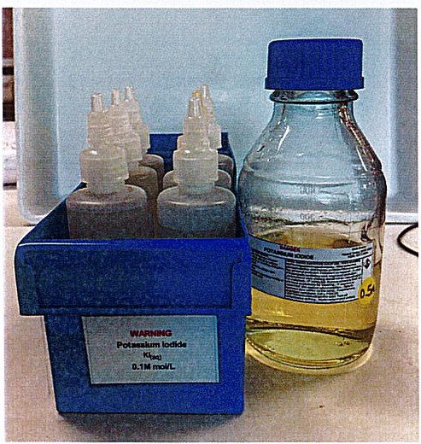
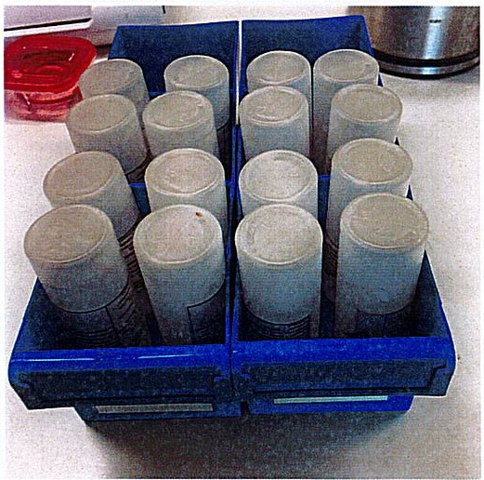
CHEM. STORE
BLUE STORAGE TRAYS
$5.50 ea OnlinePlastics
Unit 12 / 7 Vesper Drive
Narre Warren VIC 3805 Australia
Call us: 03 9704 8822
, SpMeP.vtsTtltf I 1oox100x300mmSparepartstrayFiscr.erPia:.10
100 X100 X300MMSPARE PARTSTRAYFISCHER PLASTICS
$5.50
Email us:
PrOOJClCO<lo· IH·012
rr:c�20i'o'iocf:1
OimcM1oru WIOOxH100x0500rrvn
M.itcrlill Poiy',Jlop"t.onc
8' M'd· RSCNM"Plastk:s
Colar......
6IUc •
Cluonttty
..' �i◄H·ii·P·'·•i ⁰
Stuhl bottles 125ml.
Dropper tops or screw caps Blue tray holds 12 bottles OR
8 bottles and a 500l Schott bottle For stock

Slide 11
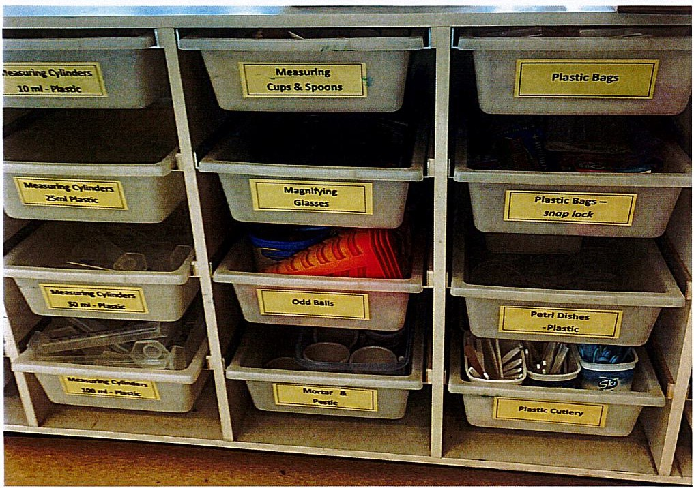
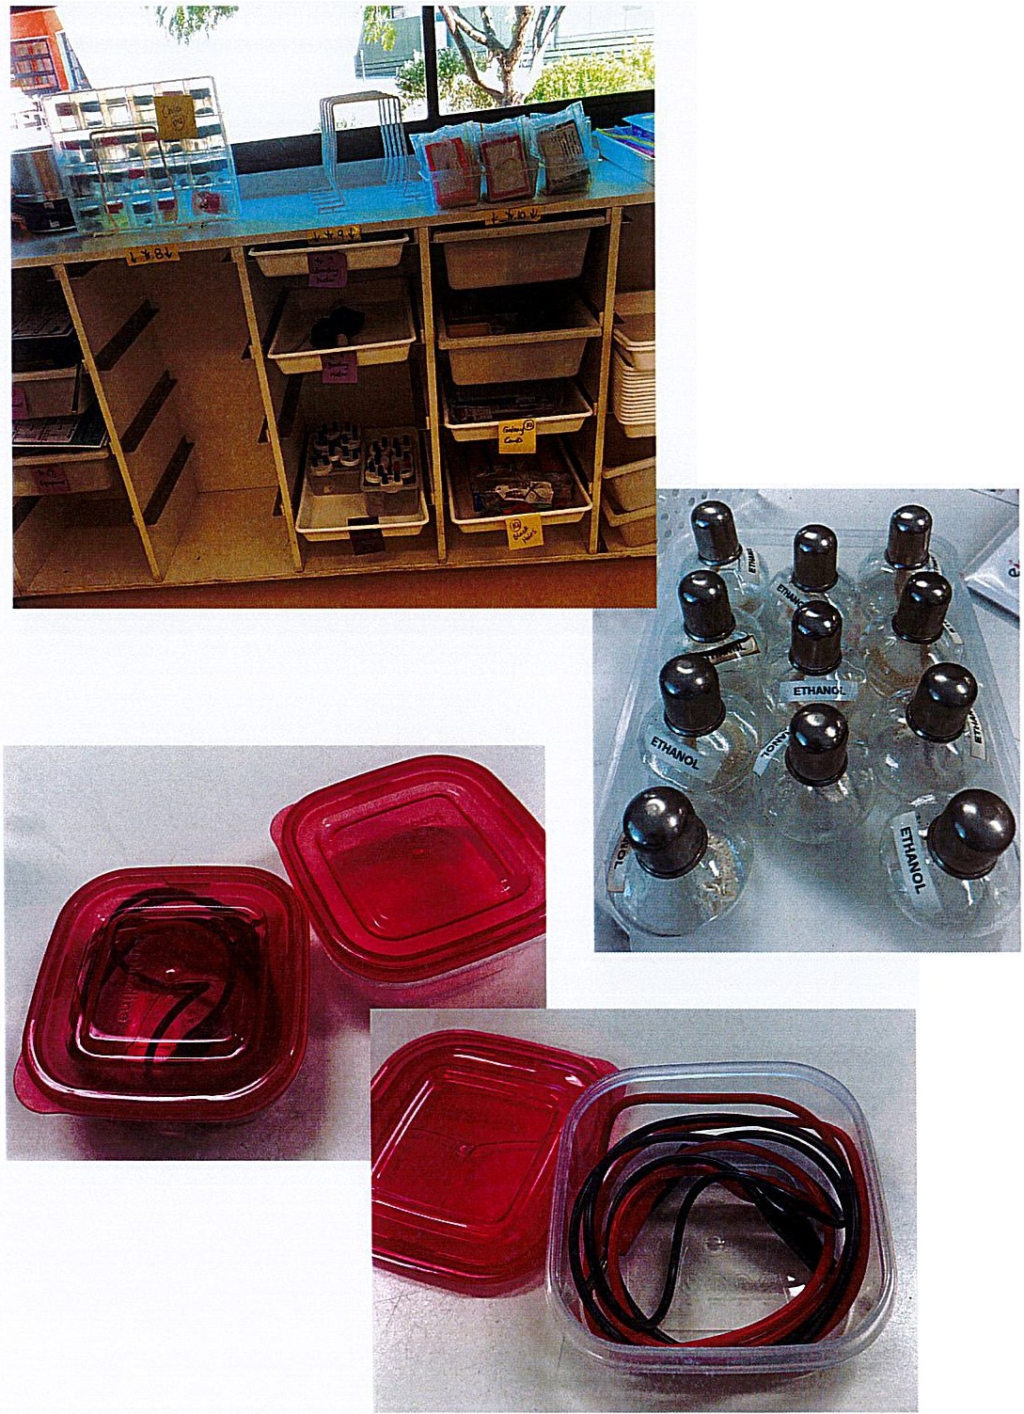
*Built in storage under a window
*Loose alphabetical sorting
*Heavy items at the bottom
*Label both Ends
Practicals ready for collection that don't require a trolley
Spirit burners - for biol lab.
Second set assorted alcohols for chemistry prac
Stored in flammable cabinet.
Red lid containers Purchase from Coles
$6 x 6 containers

Slide 12
LAB NOTES : / make these as a reference to what has been done, and what equipment I need to provide or buy to run the unit. It also has a list of DVD's that are on the drive to support the learning. I don't have to remember everything year to year.
Senses - Lab Notes
TOUCH - Skin Structure - Nerve Structure Nerve endings - Nails on a ruler
HOT & COLD- 3 buckets with ice water, tap water, warm (650) water Fake Arm - arm in a lab coat with rubber glove stuffed and box or screen. Combs - Kathleen
Copper Pipe, cardboard tube, plastic pipe
HEARING - Audacity, McGurk, Ear Models cochlea and ??
SIGHT
Eye Dissection lshiara Cards Optical Illusions
SMELL
*Small vials (14} with mostly essential oils
*3 bottles -Apple juice, Pear juice, Potato Juice (In freezer frozen for the next class) Tasting Cups
Sunburst Lollies - Set up in vials for tasting. Air Freshener
Skull from skeleton
Sagittal plane rat - can see sinus

Slide 13
TASTE
PTC paper
Tongue Mapping - Sweet, Salt, Sour, Bitter - sugar, lemon juice, tonic water
salt,
Coloured water - green, red, yellow - ALL Strawberry
Tasting Cups - Sweet(sugar) Sour(lemon juice) Bitter(tonic water) Salt (salt)
Toothpaste & Orange Juice (TicTacs)
Blue food dye to colour for super tasters & Tongue shields
DVD List
BBC Series - Taste, hearing, sight, smell
(20)
Scope - smell (23)
Sight (43) Sleek Geeks
RANDOM INFORMATION - ICE BATH
We use supa dupa's
Put in the water bath to reduce the temp. for an ice bath Works better than ice blocks they don't melt and increase the volume of water.
When you are finished, take them out dry, put back in the freezer for next time. Mine are 8 years old.
Mark the tray- DO NOT EAT!!

Slide 14
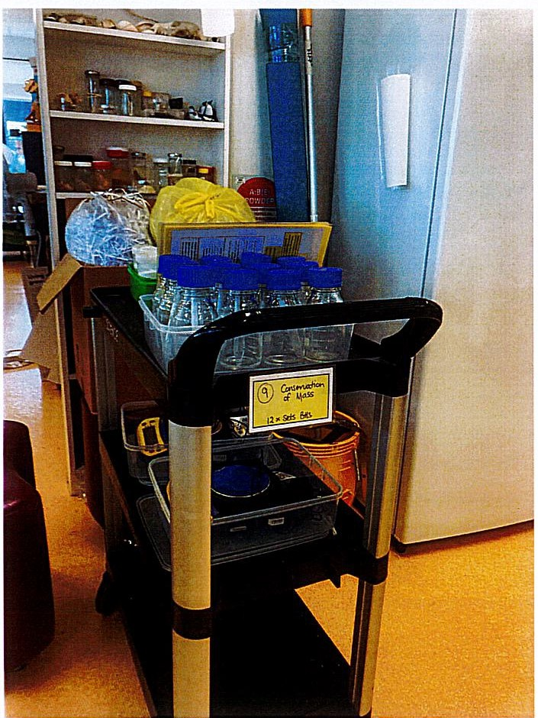
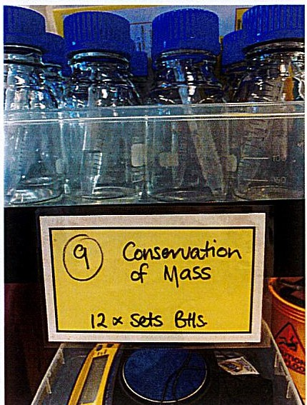
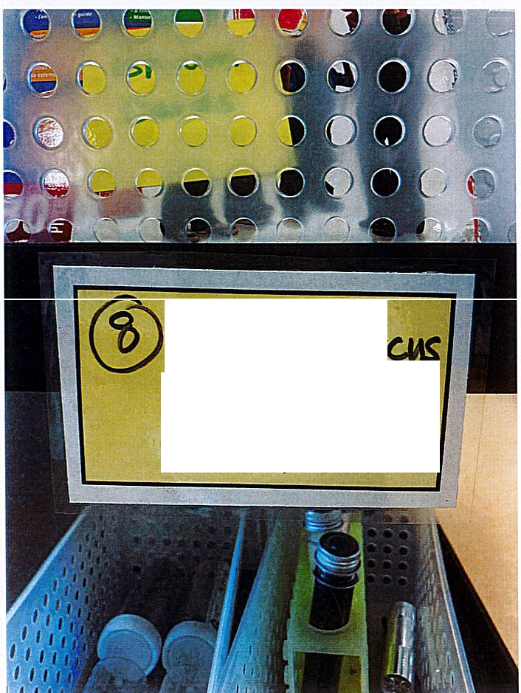
Trolley Labels

Slide 15
Making Iodine soln.
Weigh up iodine to concentration required.
ADD Kl - potassium iodide to 150ml water. Add iodine - it will dissove much faster.
When dissolved, make up to volume with water.
Making Starch soln.
Weigh up starch to concentration required.
ADD 50ml cold water and stir to distribute starch. Make up to volume with boiling water from the kettle.
Stir continually. - readymade, just cool to pour into bottles
Empty bottle when pracs. Are finished, empty, rinse and store upside down without lids ready for the next time you need them. Keep labelled.
Do this for solutions of enzymes, empty and keep the labelled bottles.
Making vegetable soln's. - Indicators
Red cabbage - shred and store in the freezer ready for kids to make acid/base indicator.
Onion skin - keep brown and red onion skins to be used to make acid/base indicator.
Strawberries (for DNA)- buy strawberries when they are cheap. Bag and store in the freezer ready to extract DNA.
The frozen water expands the cells to give more DNA. Can do the same with banana, kiwi fruit or any other fruit.

Slide 16
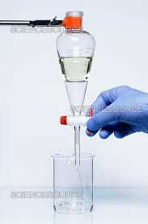
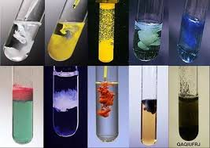
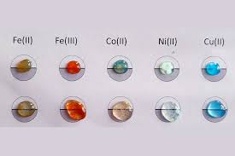
CHEMICAL DISPOSAL – Try to keep the waste chemicals separated so they can be dealt with individually
**After Esters………..
Buy a large separating funnel
Keep all the waste
Pour into the separating funnel and allow to stand to separate out the water and the ester.
Drain off the water carefully and to up with more waste, until you have separated all the waste and disposed of the water.
(We have 3 chem classes so lots of waste)
Pour into a 1L beaker to give a larger surface area, put in the fume cabinet and turn on, leave on till all the esters have evaporated.
PRECIPITATE WASTE
Eliminated at CESC
Use 0.1M solutions in dropper bottles
We do precipitates on a laminated card.
TWO drops of each, record the result.
Wipe clean with paper towel
Dispose of the paper towel in a
separate waste bag.
BIN !!

Slide 17

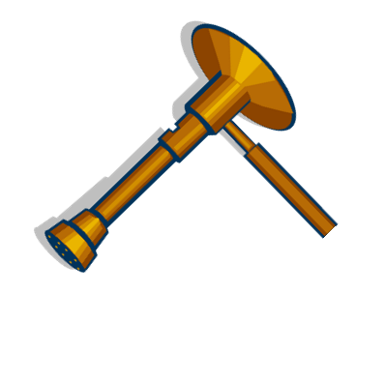
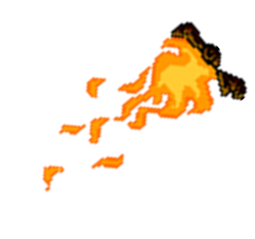
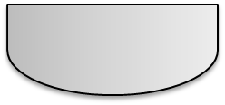


FLAME TEST WASTE
Only use carbonates to test.
ADD 10ml of HCl to an evaporating basin.
Using a Bunsen Burner on YELLOW FLAME; hold it at the side of the basin to record the flame colour
Keep all the waste separate I use labelled 600ml beakers)
Choose the right chemicals and you hardly have any waste to dispose of. All the wastes are chlorides.
Sodium Potassium & Magnesium can go down the sink.
Barium and Copper can be precipitated out using NaOH , filtered and disposed of wrapped and in the waste bin.

Slide 18
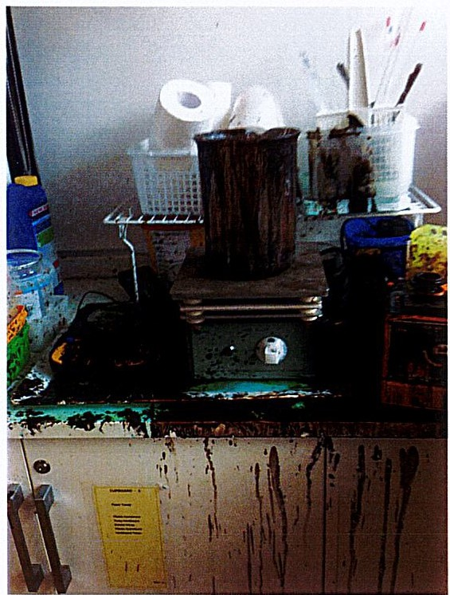
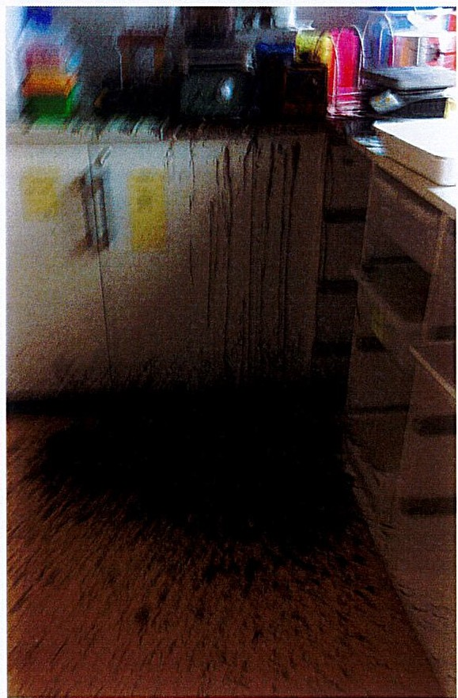
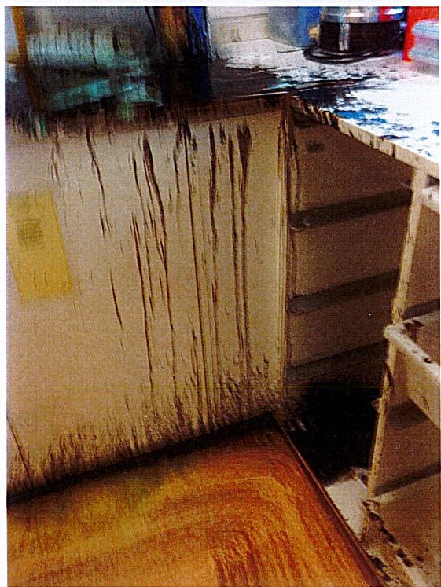
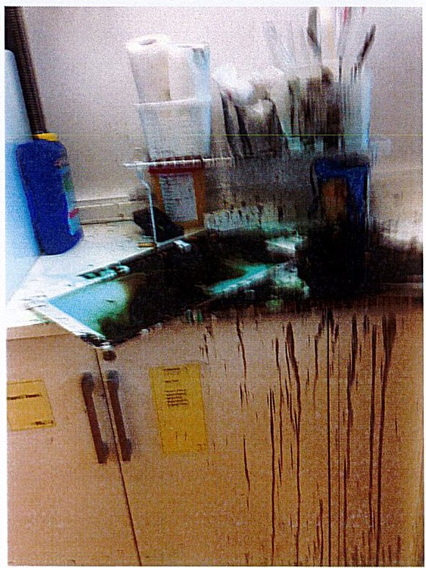
When it all goes horribly wrong !!
Pushed for time, when you don’t have help.
At least nobody was injured

Slide 19
Hours of scrubbing and cleaning

Slide 20
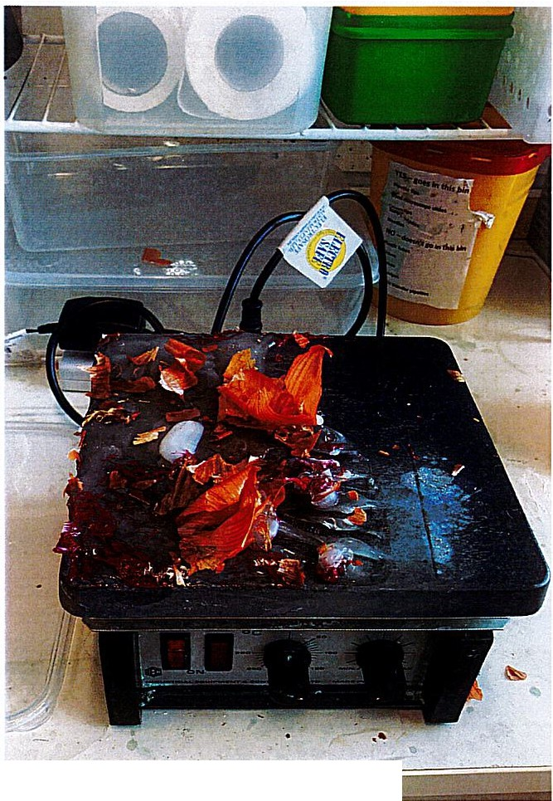
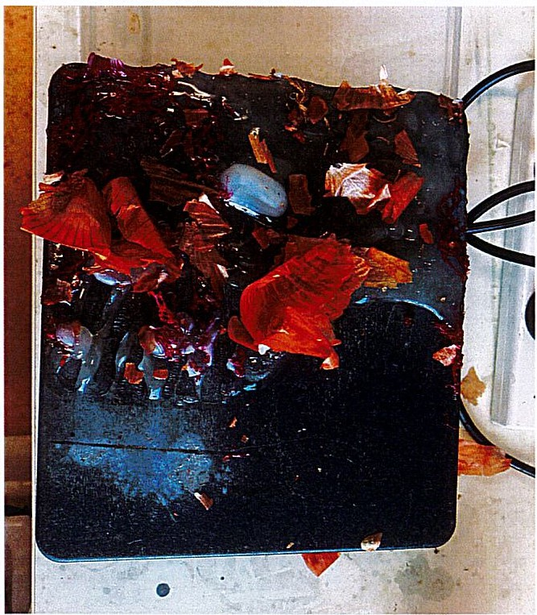
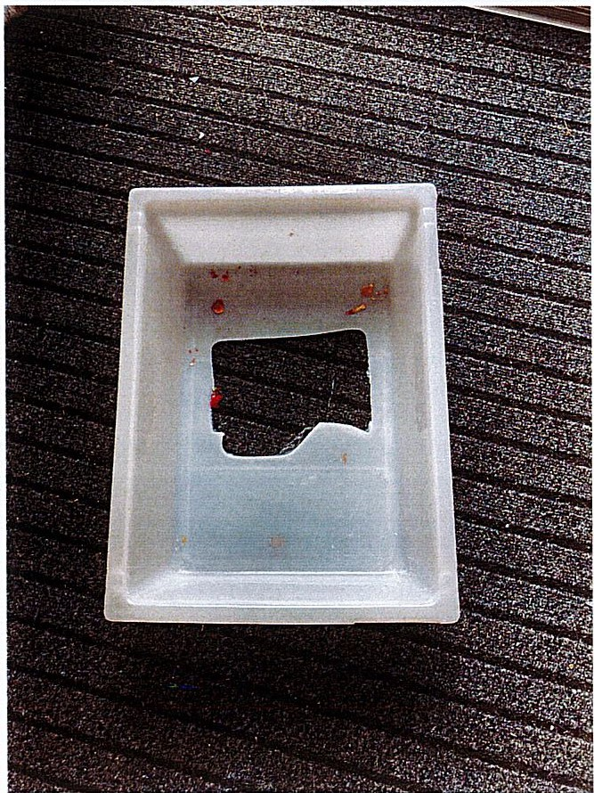
When it all goes wrong
NOTE : Don't cook onions in a plastic tub on a hot plate. The onions burn, the plastic melts and everything sticks to the hot plate. Brain fade moment when I thought the hot plate was off!!

Slide 21
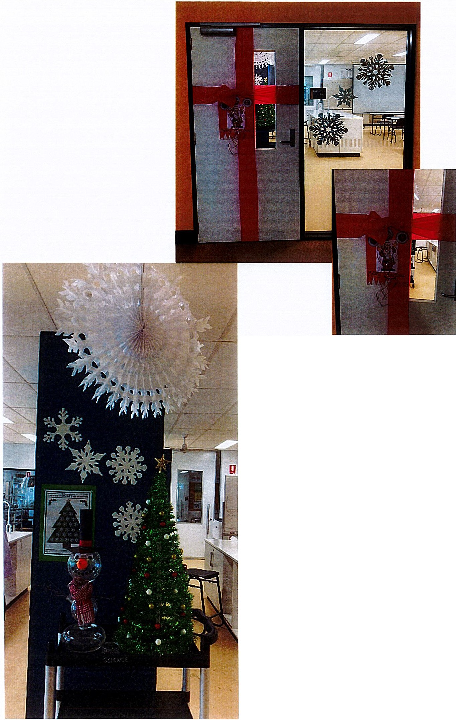
Merry Christmas
To All the Techs� @ LabCon

