Slide 1

Iris Avery
Balwyn High
ima@balwynhs.vic.edu.au

Slide 2

Equipment to make things easier
Silicon stoppers
Electrolysis brownlee apparatus
Black spotplates 3D
White test tube holders 3D
Small petri dishes
Carbon models
Heating agar

Slide 3

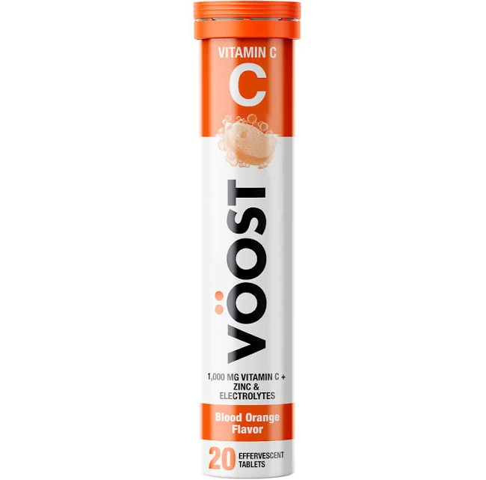
That pesky prac!
Determination of Vitamin C with Voost
Greenhouse effect
Determining phosphate in fertiliser
Determining chlorine in pool water
Orgimai organelles
https://origamiorganelles.com/
Photosynthesis with spinach and DCPIP
Reaction rates Iodine clock

Slide 4


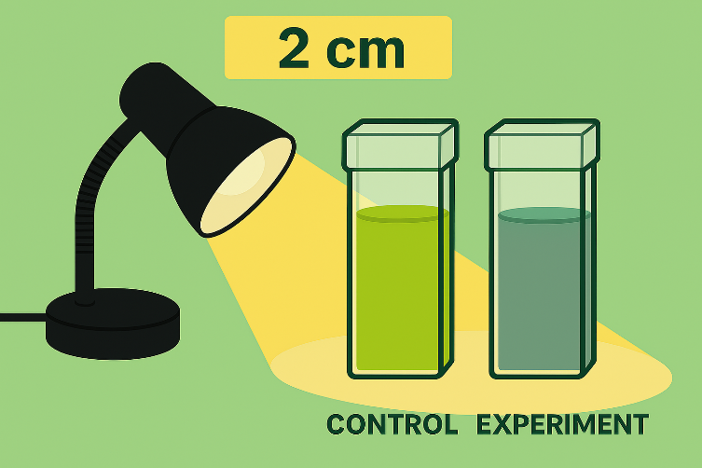
DCPIP Solution
Buffer Solution:
Dipotassium phosphate and Monopotassium phosphate
Curvettes with lids
Lamps
Spinach or geranium leaves

Slide 5
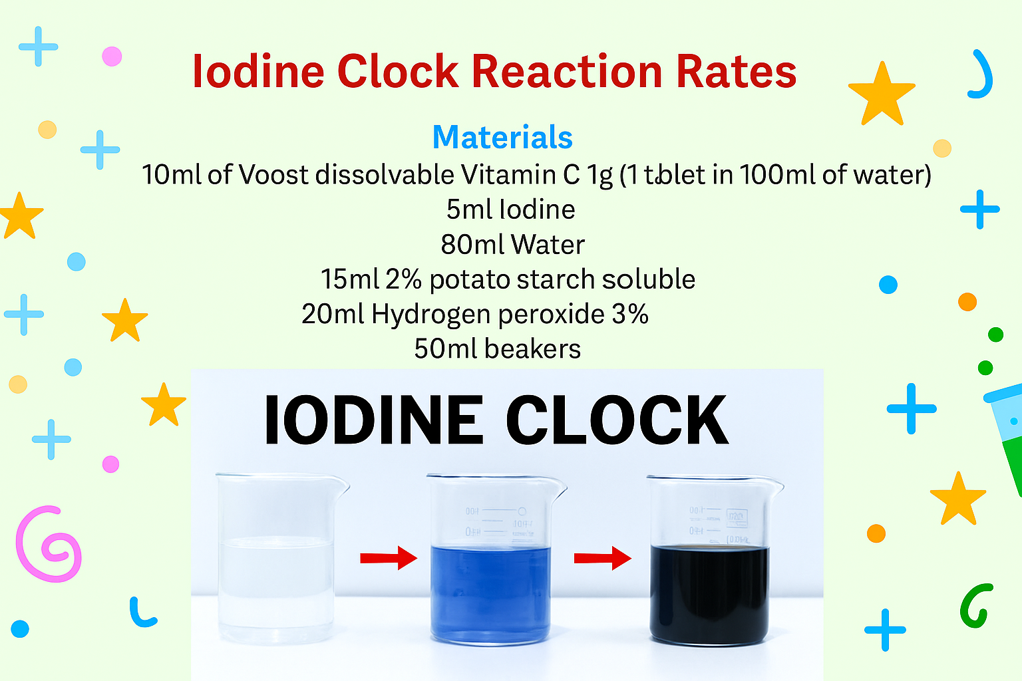

Slide 6

How can I make this prac easier?
Q & A’s

Slide 7

Now to make it FUN!
Saber lights lightsabers
Bow and arrow Bow and arrow instructions
Ice cream Make your own ice cream
Grass heads steam grass heads

