Slide 1


Safety in school laboratories and mastering ASTA's Science Assist
Dale Carroll

Slide 2
Session Objectives
Learn about Science Assist and how we can help you make science education safer and more enjoyable
Learn how to master the NEW Science Assist webpages
Explore our most popular resources
Discover how our expert science advisory team can help with real-life questions.
Notes:
Session Objectives: Learn how to master the ASTA's Science Assist webpages with this interactive session that will explore our most popular resources that can help you to prepare for your next science lesson. Discover how our expert science advisory team can help with real-life questions and how Science Assist can help you to make science education safer and more enjoyable.

Slide 3
What is Science Assist ?
Notes:
Science Assist is a national online advisory service for school science educators and technicians.
Science Assist provides access to expert-curated teaching resources for K–12, Science Curriculum support, comprehensive lab safety guidance, and a wide range of practical, inquiry-based science activities.

Slide 4
What do we provide?
High-quality teaching and learning resources
Safety-compliant practical activities
Australian Curriculum resource: Science
Advice on all aspects of school laboratory safety, management and design
Notes:
Expert, up-to-date information on high-quality teaching and learning resources
Support for teachers in the implementation of the Australian Curriculum
An extensive range of educationally sound and safety-compliant practical activities for a hands-on, inquiry-based study
Consistent and authoritative advice on all aspects of school laboratory safety, management and design
Support for school laboratory technicians and teachers in the delivery of stimulating and practical science activities

Slide 5
New Science Assist web pages
https://asta.edu.au/scienceassist/
Notes:
Attendees can follow along via their mobile devices or laptops if they wish for a live experience.

Slide 6
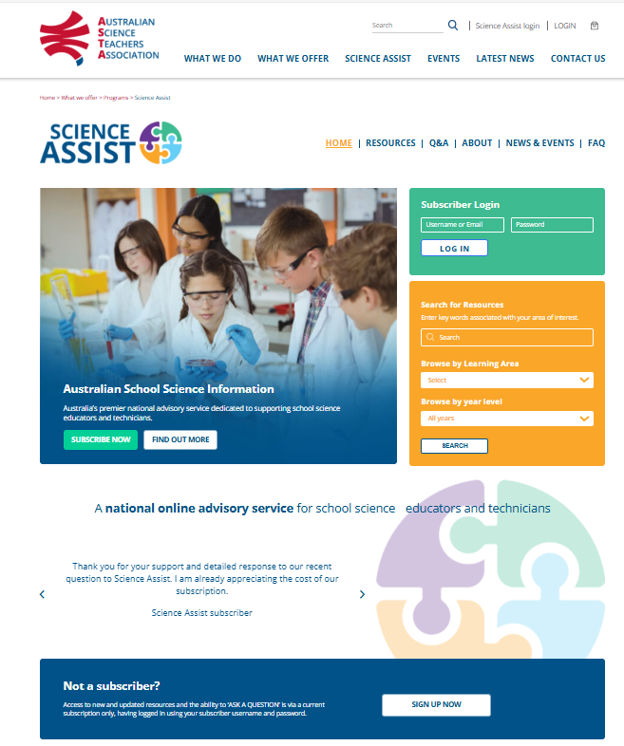
Science Assist Webpages Login
Science Assist subscribers login via the ASTA home page or from the top navigation bar to access paywall content or ‘ask’ questions.
You can log in by either using your subscription ID number or the email address associated with your account.
Notes:
Our Science Assist Subscribers will be able to login via our Home page or from the top navigation bar to access paywall content or “ask” a questions.
You can log in by either using your subscription ID number or the email address associated with your account.

Slide 7
Home page

Slide 8
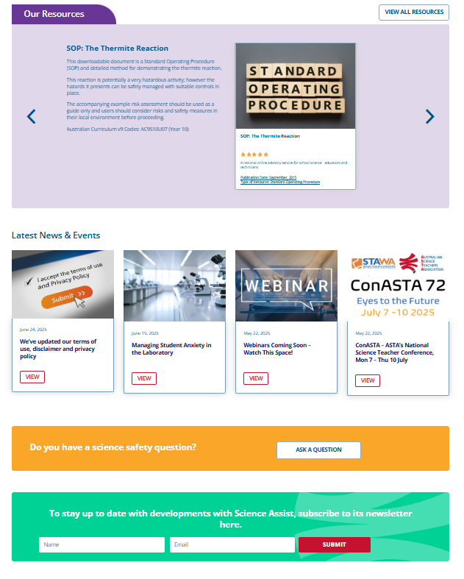
Notes:
Our Home page provides snapshot one page and you can stay up to date by seeing our most recent resources, events and news articles
It gives you easy access with quick links to popular tools.
You can register for our newsletter or other important information we might share from time to time.
You can read testimonials from other satisfied subscribers

Slide 9
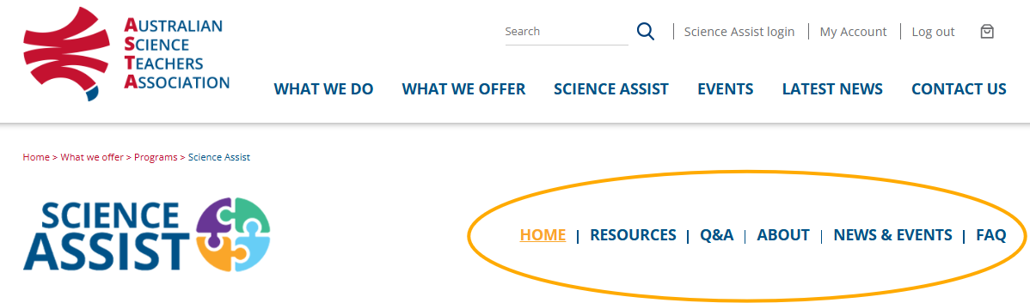
How to navigate the web pages
Home page
Resources
Q&A (Questions and answers)
About
News and events
FAQ (Frequently Asked Questions)
Notes:
The new Science Assist site has 6 web pages that can be found on the navigation bar at the top of Science Assist site
Home Page
Resources
Q&A
About
News & Events
FAQ

Slide 10
Resource page

Slide 11
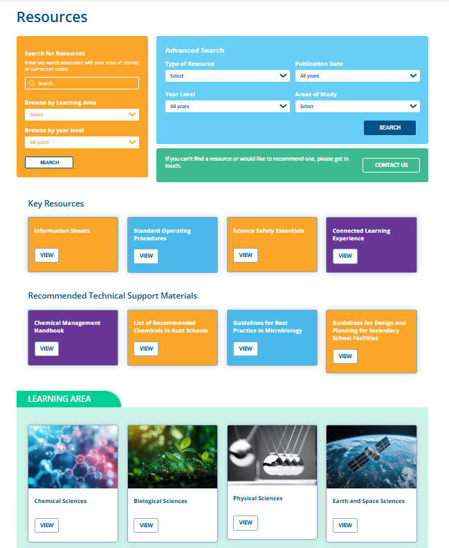
We now have all resource libraries on one page for easy navigation
Key resources
Recommended technical support materials
Resource learning areas
Notes:
We now have all resource libraries on one page for easy navigation. These include:
Key Resources
Recommended Technical Support Materials
Learning Area
*NOTE : Due to the amount of information transferred from the original Science Assist website to the new ASTA website there may be some resources that have PDF documents that contain links that redirect you to the old site. We will be working through these resources over the next few months to replace these links with the correct URL link for that resource on the NEW ASTA website. You can still search for the title of the resource link in the PDF in our new website.
If you do notice content on our page not working or links that are incorrect then please contact us
From August 2025 our previous Science Assist website will be decommissioned. Any previous URL links that you have saved will no longer work after this date. All resources from the old website were transferred so you can use our search engine tool to find the resources on the new website.

Slide 12
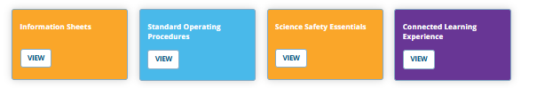
Key resources
Assist Information Sheets (AIS)
Standard Operating Procedures (SOP)
Science Safety Essentials (SSE)
Connected Learning Experiences (CLE)
Notes:
Our key resources libraries can now all be found on our main resource page.
Assist Information Sheets
Standard operating procedures
Science Safety Essentials
Connected learning Experiences
Note: Used to be separate tabs on the old website

Slide 13
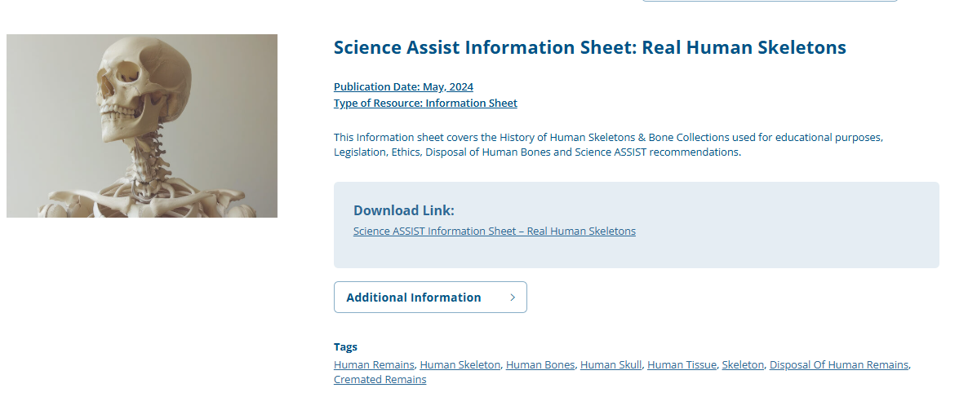
Assist Information Sheet (AIS)
An Assist Information Sheet is a downloadable document that is designed to provide schools with general guidelines on a particular subject
Notes:
An ASSIST Information Sheet is a downloadable document that is designed to provide schools with general guidelines on a particular subject.
Downloadable documents designed to provide schools with general guidelines on a particular subject. Chemical Storage / Safety Shower and Eyewash / Risk Assessment / Lab Safety & First Aid Skills / Spill Kits / Chemical Labels / Plant & Equipment Maintenance and Servicing / Latex Allergies / Footwear / Lab Glass Disposal etc.

Slide 14
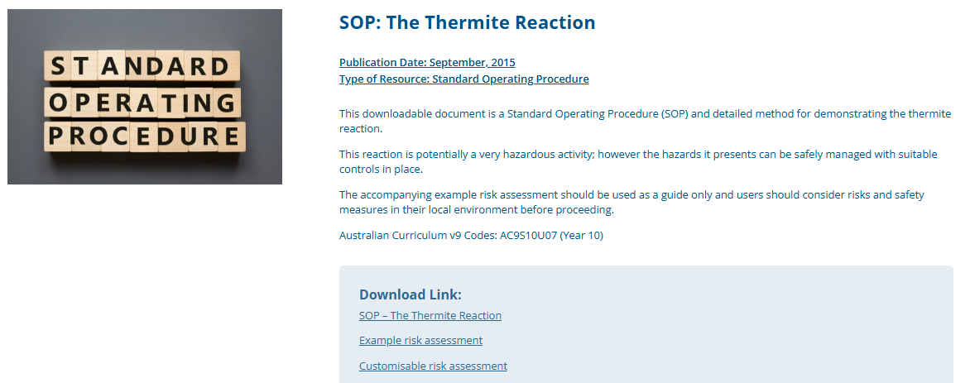
Standard Operating Procedures (SOP)
A Standard Operating Procedure (SOP) is a set of step-by-step instructions for performing routine tasks safely, consistently and efficiently.
Notes:
A Standard Operating Procedure (SOP) is a set of step-by-step instructions for performing routine tasks consistently and efficiently. They ensure that tasks are completed in the same way every time, promoting uniformity, reducing errors, and facilitating compliance with regulations. SOPs cover a wide range of activities, from simple tasks to complex processes,
Standard Operating Procedure (SOP) Template has also been developed by Science ASSIST which can be used to create your own SOP.

Slide 15
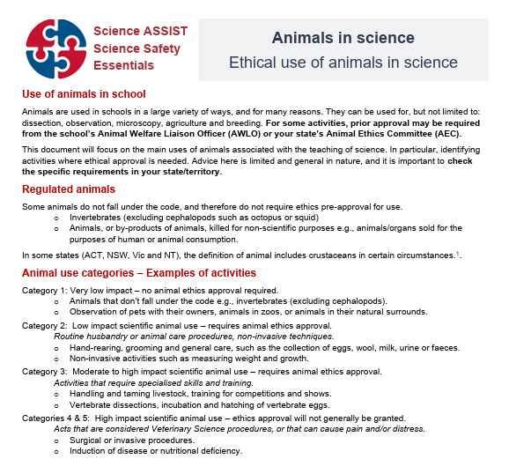
Science Safety Essentials (SSE)
The Science Safety Essentials resources are designed to be a quick reference guide.
They are a series of one-page documents that highlight the key information.
Notes:
The Science Safety Essentials resources are designed to be a quick reference guide for new and out-of-field science leaders and teachers. They are a series of one-page documents that highlight the key information needed to identify the responsibilities that a science leader has across a range of complex topics, each with a companion documents called Science Safety Essentials Talks.
The series includes the following topics:
Science Safety Essentials Animals in science
Science Safety Essentials First Aid Kits in science
Science Safety Essentials Lasers in science
Science Safety Essentials Radiation sources in science
Science Safety Essentials Risk assessment in science
Science Safety Essentials Risk management in science

Slide 16
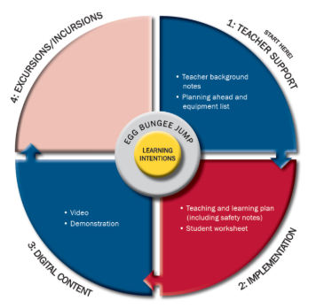
Connected Learning Experiences (CLE)
A Connected Learning Experience (CLE) is a resource package designed to support the use of inquiry investigations in the classroom.
Notes:
A Connected Learning Experience (CLE) is a resource package designed to support the use of inquiry investigations in the classroom.
https://youtu.be/8wMNImqhVeE

Slide 17
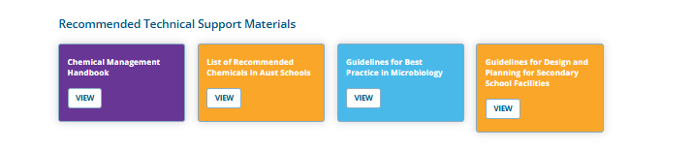
Recommended Technical Support Materials
Chemical Management Handbook
List of Recommended Chemicals in Australian Schools
Guidelines for Best Practice in Microbiology
Guidelines for Design and Secondary School Facilities
Notes:
We have highlighted a few of popular Technical Support resources on our main resource page so that they are easy to find
Chemical Management Handbook
List of Recommended Chemicals in Australian Schools
Guidelines for Best Practice in Microbiology
Guidelines for Design and Secondary School Facilities

Slide 18
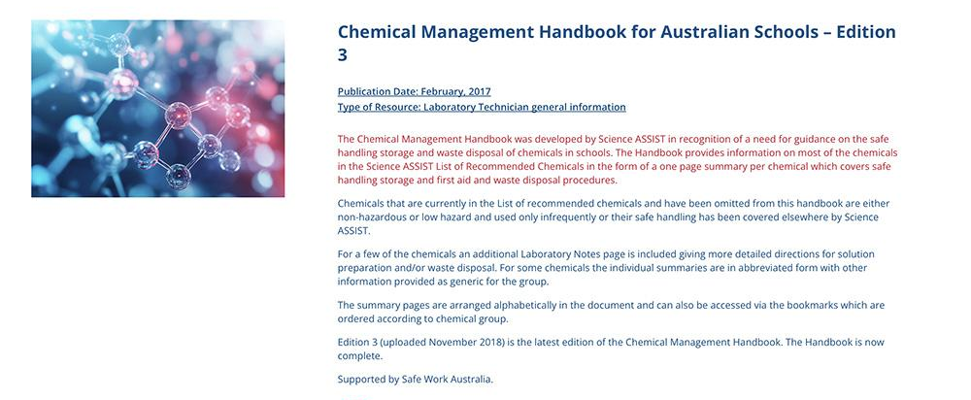
Chemical Management Handbook
Our Chemical Management Handbook provides information on most of the chemicals in the Science ASSIST List of Recommended Chemicals in the form of a one-page summary per chemical, which covers safe handling, storage and first aid, and waste disposal procedures.
Notes:
Guidance on the safe handling, storage and waste disposal of chemicals in schools
The Handbook provides information on most of the chemicals in the Science ASSIST List of Recommended Chemicals in the form of a one-page summary per chemical, which covers safe handling, storage and first aid, and waste disposal procedures

Slide 19
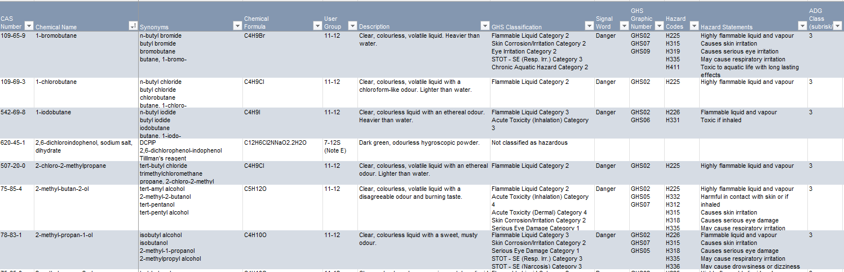
List of Recommended Chemicals in Australian Schools
The List of Recommended Chemicals is a reference list of chemicals which Science Assist has determined are suitable for use in schools and appropriate for modern school science teaching practices.
Notes:
The List of Recommended Chemicals is not intended as a prescribed stock list, but rather as a reference list of chemicals which Science ASSIST has determined are suitable for use in schools and appropriate for modern school science teaching practices. The List is not intended to supersede the advice of the educational jurisdictions; schools are subject to the policies and directives of their educational jurisdiction with regard to the use of chemicals in science.
The hazard information given within the list is intended as a guide. The manufacturer’s SDS should be consulted for the manufacturer’s classification of their product. Science ASSIST does not make any guarantee as to the accuracy of the information contained within this document and does not take responsibility for any adverse outcome resulting from its use. Users should make their own assessment regarding the suitability of a chemical for their purpose.
The original List of Recommended Chemicals was developed in 2016 to address the significant variations existing between the practices and local policies of the states and territories and educational jurisdictions.
A review of the List has been undertaken with some significant changes and refinement for the school context.

Slide 20
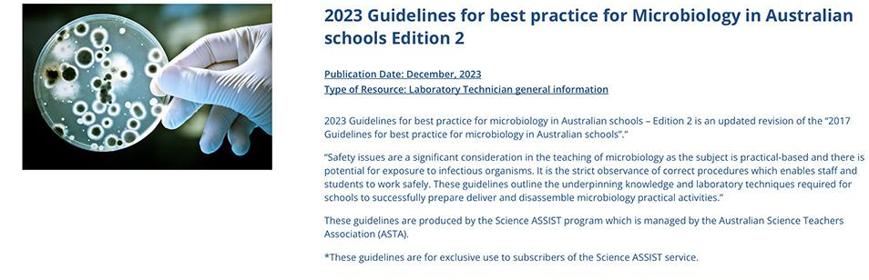
Guidelines for Best Practice in Microbiology
These guidelines outline the underpinning knowledge and laboratory techniques required for schools to successfully prepare, deliver and disassemble microbiology practical activities in a manner designed to eliminate the risk of infection.
Notes:
These guidelines outline the underpinning knowledge and laboratory techniques required for schools to successfully prepare, deliver and disassemble microbiology practical activities in a manner designed to eliminate the risk of infection.

Slide 21
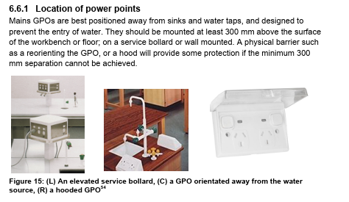
Guidelines for Design and Secondary School Facilities
Science Assist has developed these guidelines to assist school personnel in the design and planning of secondary school science facilities in Australian schools.
Notes:
There have been no nationally established guidelines for the design of school science areas
Guidance to assist school personnel in the design and planning of secondary school science facilities in Australian schools
Secondary school science facilities comprise science teaching laboratories preparation and storage areas as well as dedicated office space for science teachers and technicians. Schools that wish to build new facilities or refurbish existing rooms often ask what the requirements are for school science facilities.

Slide 22
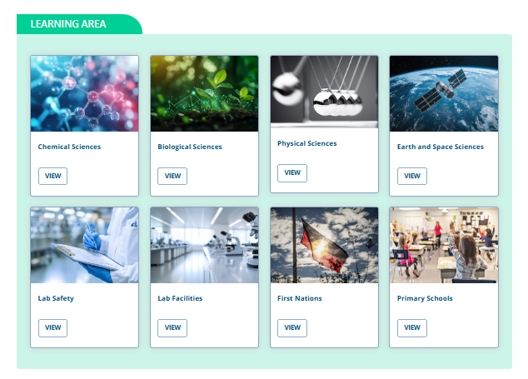
We have Key Learning Areas to help make it easy to find a Science area, topic or resource
Notes:
We now have Key Learning Area libraries to help make it easy to find a topic or resource.
Chemical Sciences
Biological Sciences
Physical Sciences
Earth and Space Sciences
Lab Safety
Lab Facilities
First Nations (More content coming late 2025)
Primary Schools (More content coming late 2025) * talk about session at ConASTA
NOTE: Over the next few months we will be building in Sub Categories for our larger Sciences Libraries, this will make it easier to find the area of Science you are looking for and replaces the previous quick links document.
If you can't find the learning area you are looking for then we have more topics and categories in our search bar “Browse by learning area”

Slide 23
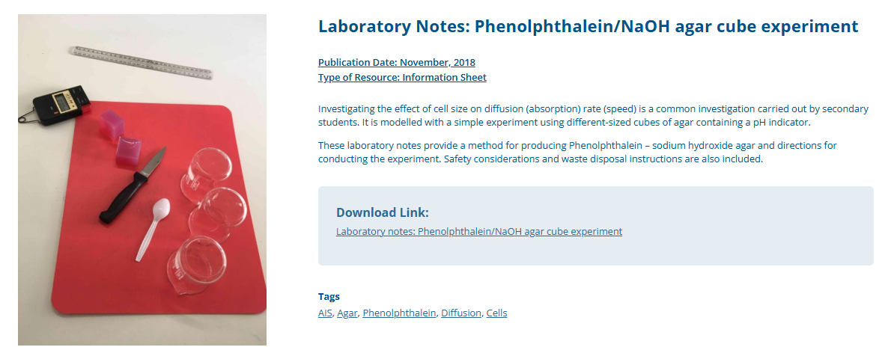
Resources
Brief introduction or overview of the article or activity.
Downloadable PDF so you can print.
Tags to find other related resources or topics
Notes:
Brief introduction or overview of the article or activity.
Downloadable PDF so you can print.
Tags to find other related resources or topics

Slide 24
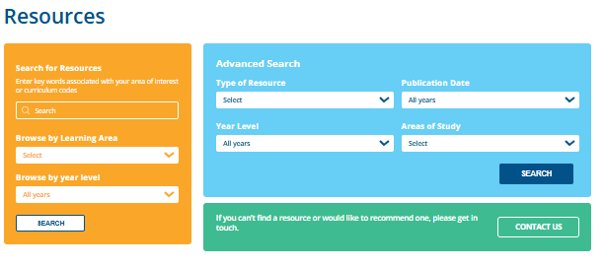
Resources – Search Function
Our search function allows you to search areas of interest, learning areas, key words, tags, year levels and curriculum codes.
You can also use our advanced search option.
Notes:
Our search function allows you to search areas of interest, learning areas, key words, tags year levels and curriculum codes.
You can also use our advanced search option.

Slide 25
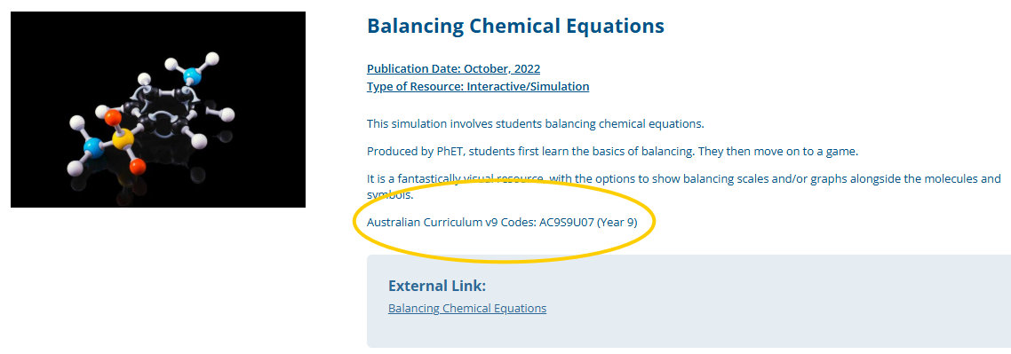
Australian Curriculum Codes
You can find references to Australian Curriculum Codes V9 along with the previous version 8.4 on relevant resources. You can search these codes in our search tool on the resource home page
Notes:
Our search function allows you to search curriculum codes.

Slide 26
Q&A – Questions & Answers

Slide 27
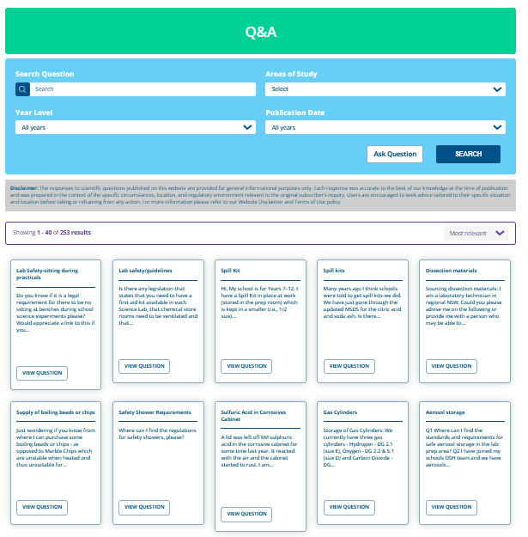
Our Q&A page is a popular tool where you can find real-life questions from schools and responses on safety issues.
Our subscribers have the ability to also ‘ask questions’ to our Science Advisors.
Notes:
Our Q&A page is a popular tool where you can find real life questions from Schools and responses on safety issues.
Our subscribers only have the ability to also “ask questions” to our Science Advisors.
You will notice that there is a disclaimer on a Q&A page. Every response on our Q&A page was answered to the best of our knowledge at the time of questions and our responses are specific to the circumstances, location, and regulatory environment relevant to the original subscriber’s inquiry.
We encouraged subscribers to seek advice by “asking a question” that we can tailor to their specific situation and location.
We have switched off the ability to rate or comment on a question. This is due to safety and legal reasons. If you do notice content on our page that is incorrect or have suggestions for improvement then please contact us at scienceassist@asta.edu.au

Slide 28
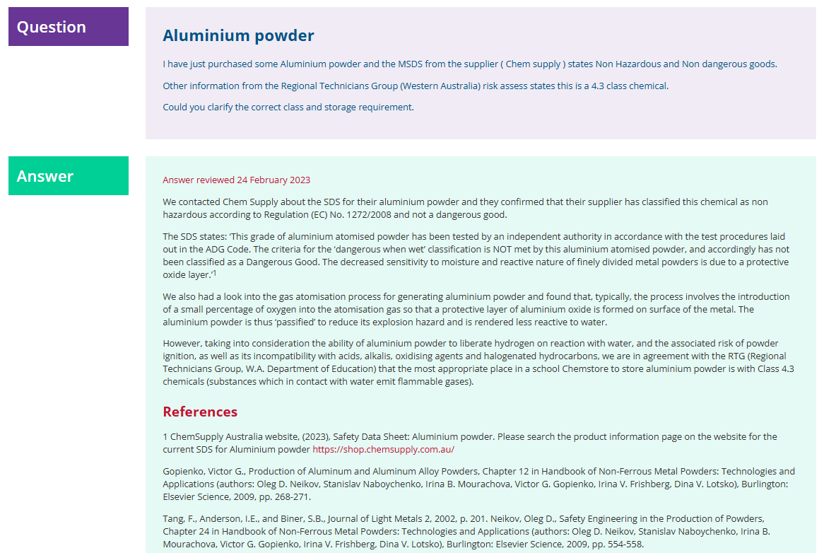
Notes:
Example of a Question and Answer

Slide 29
About Page – Science Assist

Slide 30
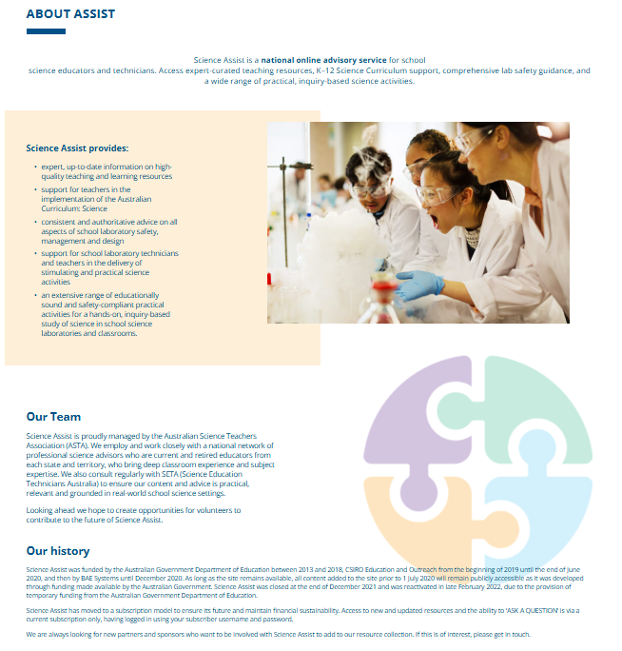
About
Science Assist
You can find out more about Science Assist on this page including:
What is Science Assist?
Our team
Our history
How to subscribe
Subscription costs.
Notes:
You can find out more about Science Assist on this page including;
What is Science Assist
Our Team
Our History
How to Subscribe
Subscription Costs

Slide 31
News and Events Page

Slide 32
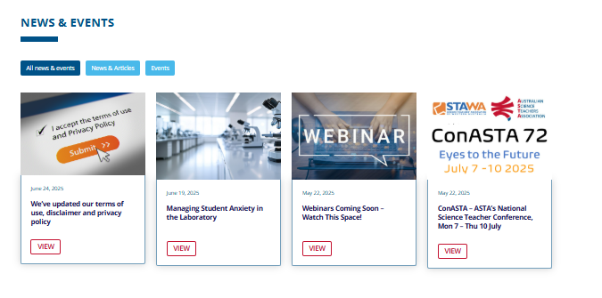
News & Events – Science Assist
Our News & Events page is a new addition to our Science Assist website. This page will keep you up to date with news, upcoming events and webinars. We will also share interesting articles and blogs on topics of interest.
Notes:
Our News & Events page is a new addition to our Science Assist website.
This page will keep you up to date with news, upcoming events and webinars.
We will also share interesting articles and blogs on topics of interest along with newsletters when they are published.

Slide 33
FAQ – Frequently Asked Questions Page

Slide 34
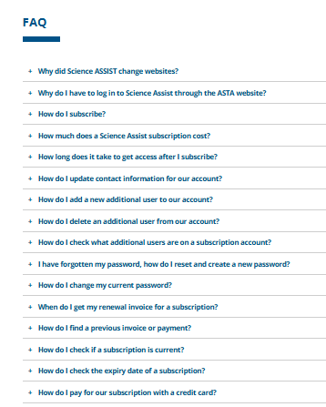
FAQs
Find information to questions about our website, along with how to instructions on:
general information
subscriptions
payments
managing your account
subscription costs.
Notes:
You can find out more about frequently asked questions about our website.
General information
Subscriptions
Payments
Managing your account
Subscription Costs
How to instructions

Slide 35
Managing your Science Assist subscription

Slide 36

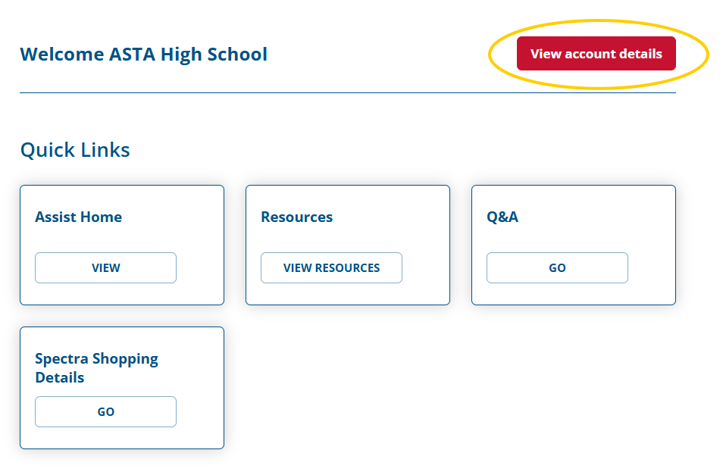
How to view your account details
Notes:
By bringing Science Assist under the main ASTA site, subscribers now benefit from a single login to manage their subscription, view past purchases and access premium content.
User can view their account information by going to “My account” and then clicking on View Account details.

Slide 37
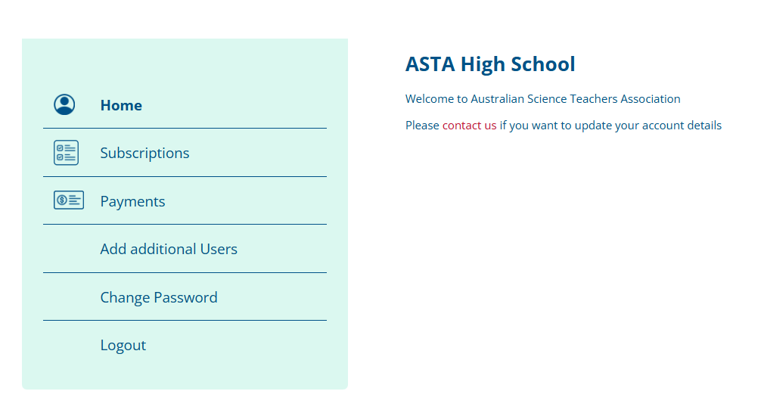
How to view your account details
We have introduced the ability for our subscribers to see their account details, manage subscriptions and add additional users.
*Note: Subscribers will still need to contact ASTA to update a primary users or schools information.
Notes:
Note: Subscribers will still need to contact ASTA to update a primary users or schools information.

Slide 38
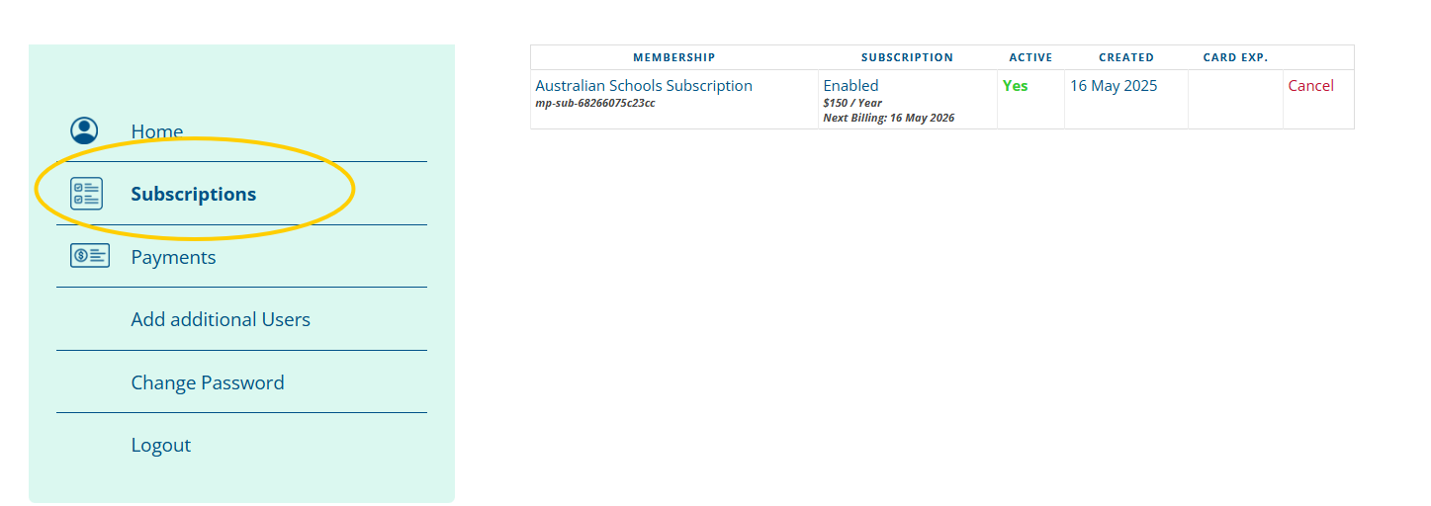
How to view your subscription
You can now check if your subscription is active and your expiry date.
From late 2025 you will be able to renew your subscription via the website and will be sent a reminder two months before your expiry.
Notes:
You can now check if your subscription is active and your expiry date
From late 2025 you will be able to renew your subscription via the website and will be sent a reminder 2 months before your expiry.
NOTE: From 2026 invoice will no longer be sent in arrears, you will receive and invoice 2 month prior to your subscription expiry, if your subscription if not paid prior to the expiry date then your subscription will become inactive.

Slide 39
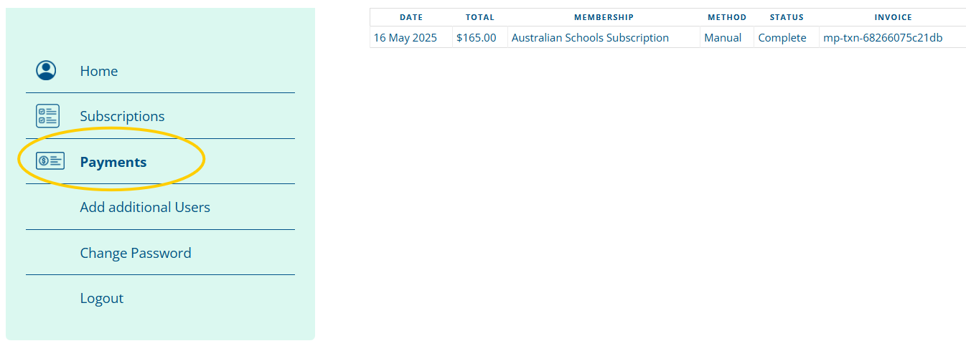
How to view your payment details
You can now check your previous payment history.
Notes:
You can now check previous payments

Slide 40
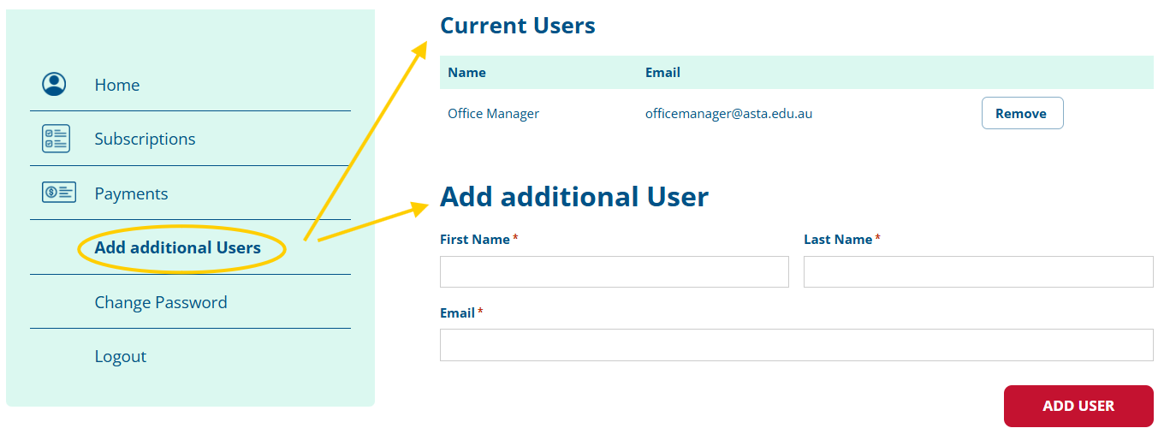
How to view / add additional users
You can now manage additional users on your school account.
Notes:
You can now add or delete additional users on your schools account. ( You have to be logged into your School or Organisations account as the owner )
Each user you added will be assigned their own login credentials. This allows additional team members to access the platform individually while remaining linked to your organisation’s account.
Each new additional user will need to verify their details via an email link sent to them before they will appear on your account profile under current users.
*Please Note: Additional account users and Individual Subscriptions do not have this functionality
Step by step instructions are on our FAQ page

Slide 41
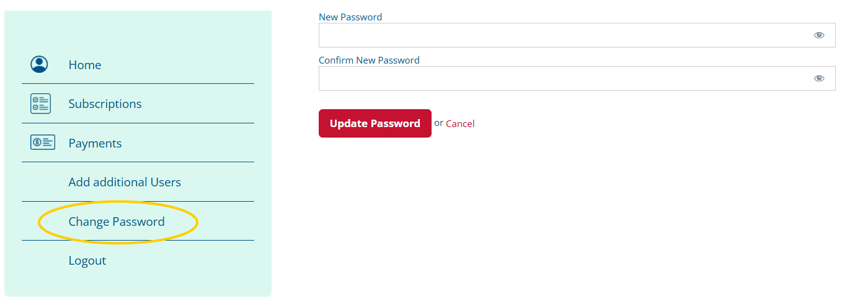
How to change your password
You change your current password via your accounts page.
Forgotten passwords can be reset via the login page.
Notes:
If you would like to change your current password you can do this via your accounts page.
Forgotten passwords can be reset via the login page.

Slide 42
New features coming
Introduction of lunchtime webinars
New Q&A responses added to library
New resources for primary schools
New resources for First Nations’ science
See subscription payment details
Add additional users to school accounts
Notes:
Introduction of lunch time webinars to subscription holders that you can use toward CPD hours.
Primary school science resources to help introduce Science to younger students and how to keep them safe
First Nations science - Indigenous Science in Australia refers to the traditional knowledge and practices of Aboriginal and Torres Strait Islander peoples related to the natural world, including astronomy, meteorology, natural resource management, bush food and medicine, and the physics and chemistry behind tools and inventions. It's a body of knowledge built on generations of observation and experimentation, often rooted in spiritual and cultural beliefs.
We have around 50 new Q&A questions and responses that will be added to the library
New functionally to help self manage your subscription account including being able to pay for your renewal subscription and add and delete new additional users to a school account.

Slide 43
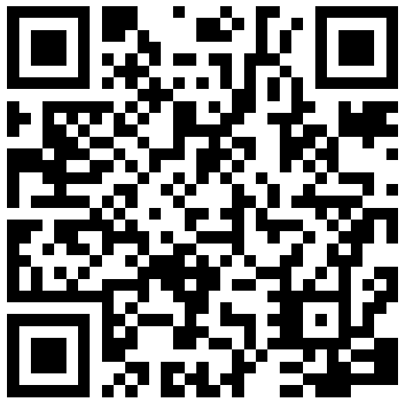
Subscribing to Science Assist
Subscribing to Science Assist is easy, just go to our website and complete on the online subscription form https://asta.edu.au/scienceassist/
Fee Structure for 2025
Australian schools $150 (ex. GST)
Australian membership (individuals) $150 (ex GST)
Australian membership (non-schools) $300 (ex GST)
Overseas membership $400 (ex GST)
10% discount until end of November for Labcon (new membereships only)
Notes:
Subscribers get access to our paywall exclusive resources, ask a questions and webinars.
Subscriptions are for 12mth from your first payment.
Payments can be via our secure online payment portal or you can request we send you an invoice.
When your payment has been successfully processed, you will be emailed your access details.

Slide 44
Summary
Science Assist is Australia’s national online advisory service for school science educators and technicians.
To streamline access and improve the overall user experience, the Science Assist NEW website is now part of the ASTA website.
The old website will be decommissioned in August 2025.
Subscribers can now manage their accounts including adding additional users.
New features in 2025 including online webinars.
10 percent discount until the end of November for Labcon attendees for new subscriptions.

Slide 45
QR code to renewal

