Slide 1

Fire in the Lab
Presented by Dale Carroll

Slide 2
Fire in the Lab
How to treat a fire.
Although a fire in the laboratory is an infrequent event, it is still good to know how to deal with it “just in case”. This session will cover the principals of fires and then how to deal with different scenarios, what extinguisher to use for what and how they operate.

Slide 3
Science Assist
SOP – Use of fire extinguishers
Example risk assessment – Use of fire extinguishers
Customisable risk assessment – Use of fire extinguishers
SOP – Fire Blankets
Example risk assessment – Fire blankets
Customisable risk assessment – Fire blankets

Slide 4
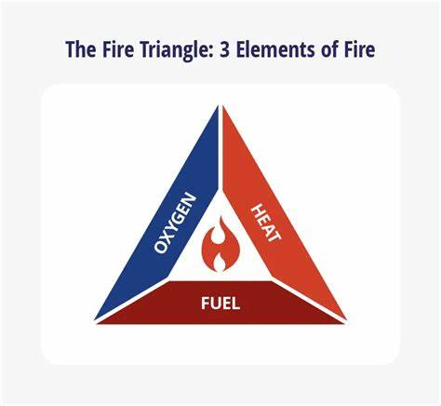
Requirements for a fire
Fuel
Oxygen
Heat

Slide 5
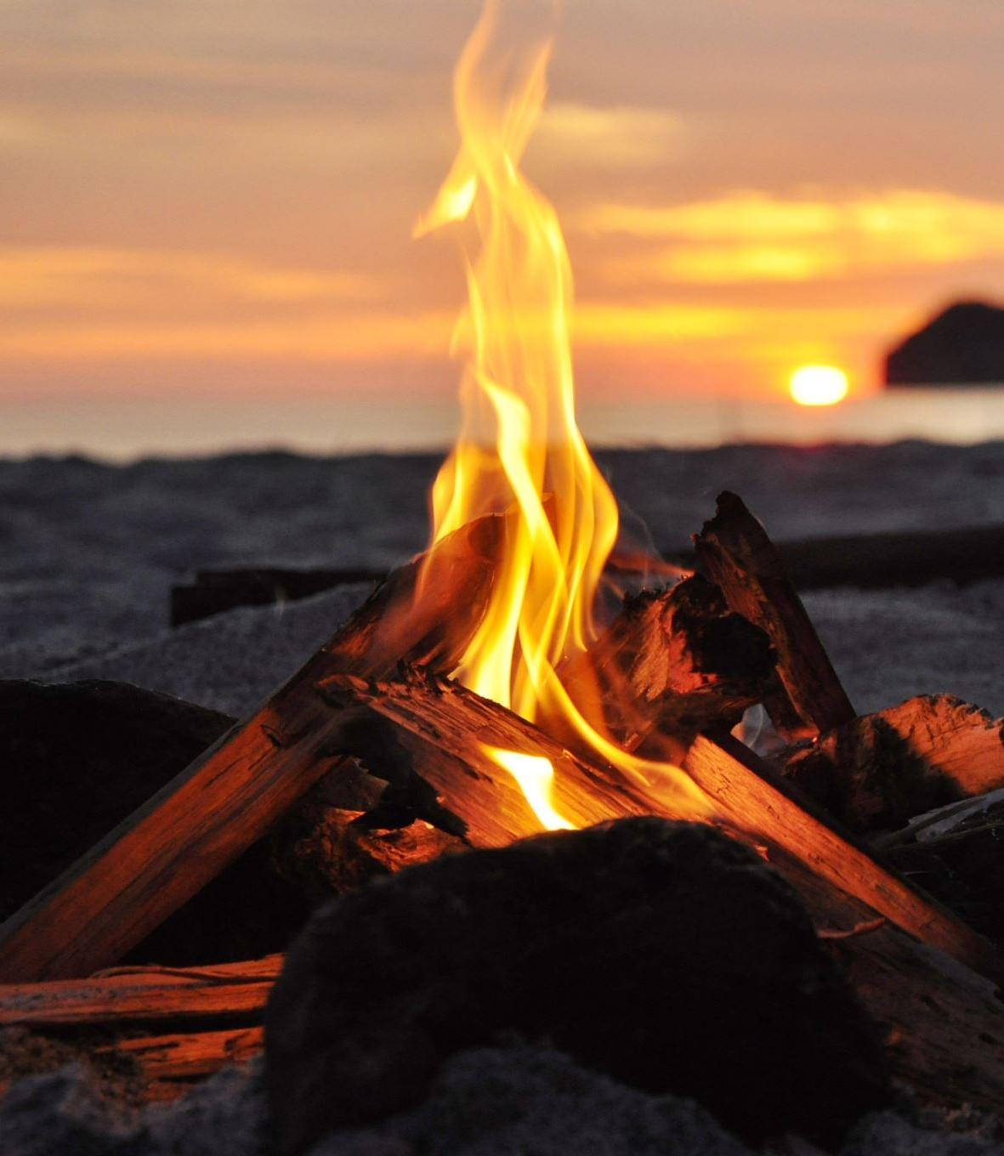
Class of fire
There are six classes of fire: Class A, Class B, Class C, Class D, Class E, and Class F.
– Class A fires – combustible materials: caused by flammable solids, such as wood, paper, and fabric
– Class B fires – flammable liquids: such as petrol, turpentine or paint
– Class C fires – flammable gases: like LPG, hydrogen, butane or methane
– Class D fires – combustible metals: chemicals such as magnesium, aluminum or potassium
– Class E fires – electrical equipment: once the electrical item is removed, the fire changes class
– Class F fires – cooking oils: typically a chip-pan fire

Slide 6
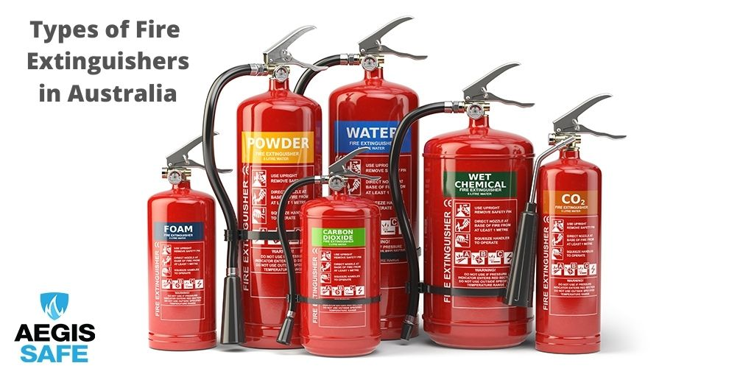
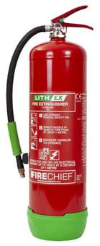
Types of fire extinguishers
– Water
– Foam
– Dry Powder – ABE
– Dry Powder – BE
– Carbon Dioxide (‘CO2’)
– Wet Chemical
– Lithium Ion

Slide 7
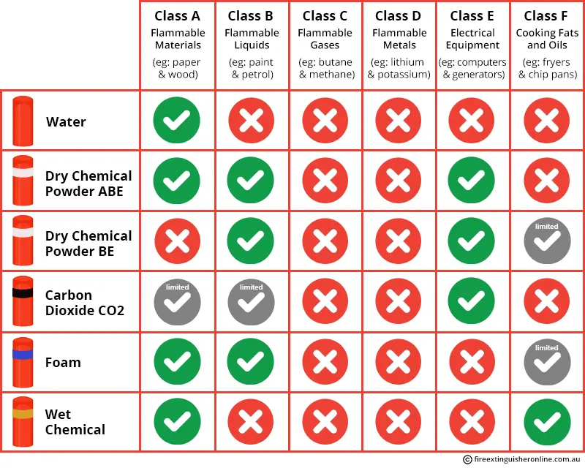
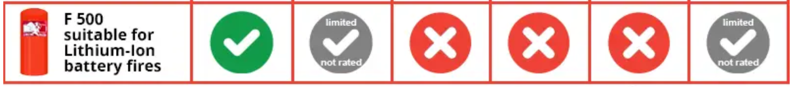

Slide 8
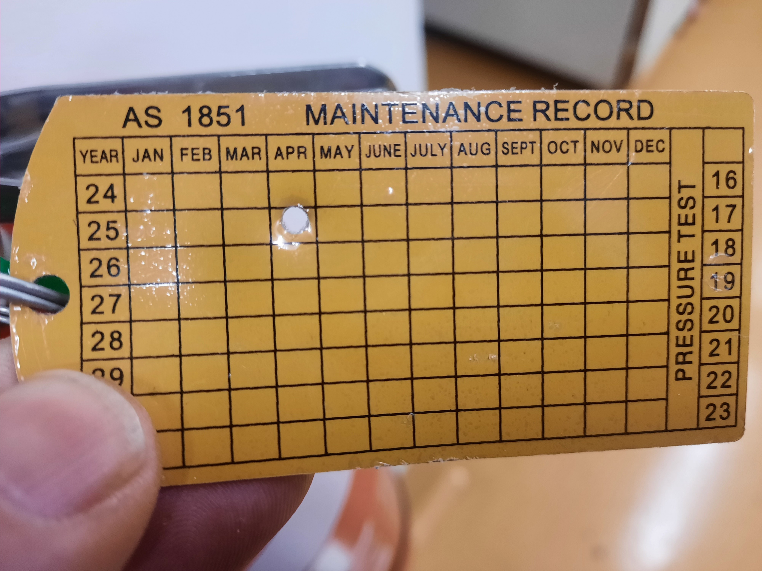
Checking fire extinguisher

Slide 9
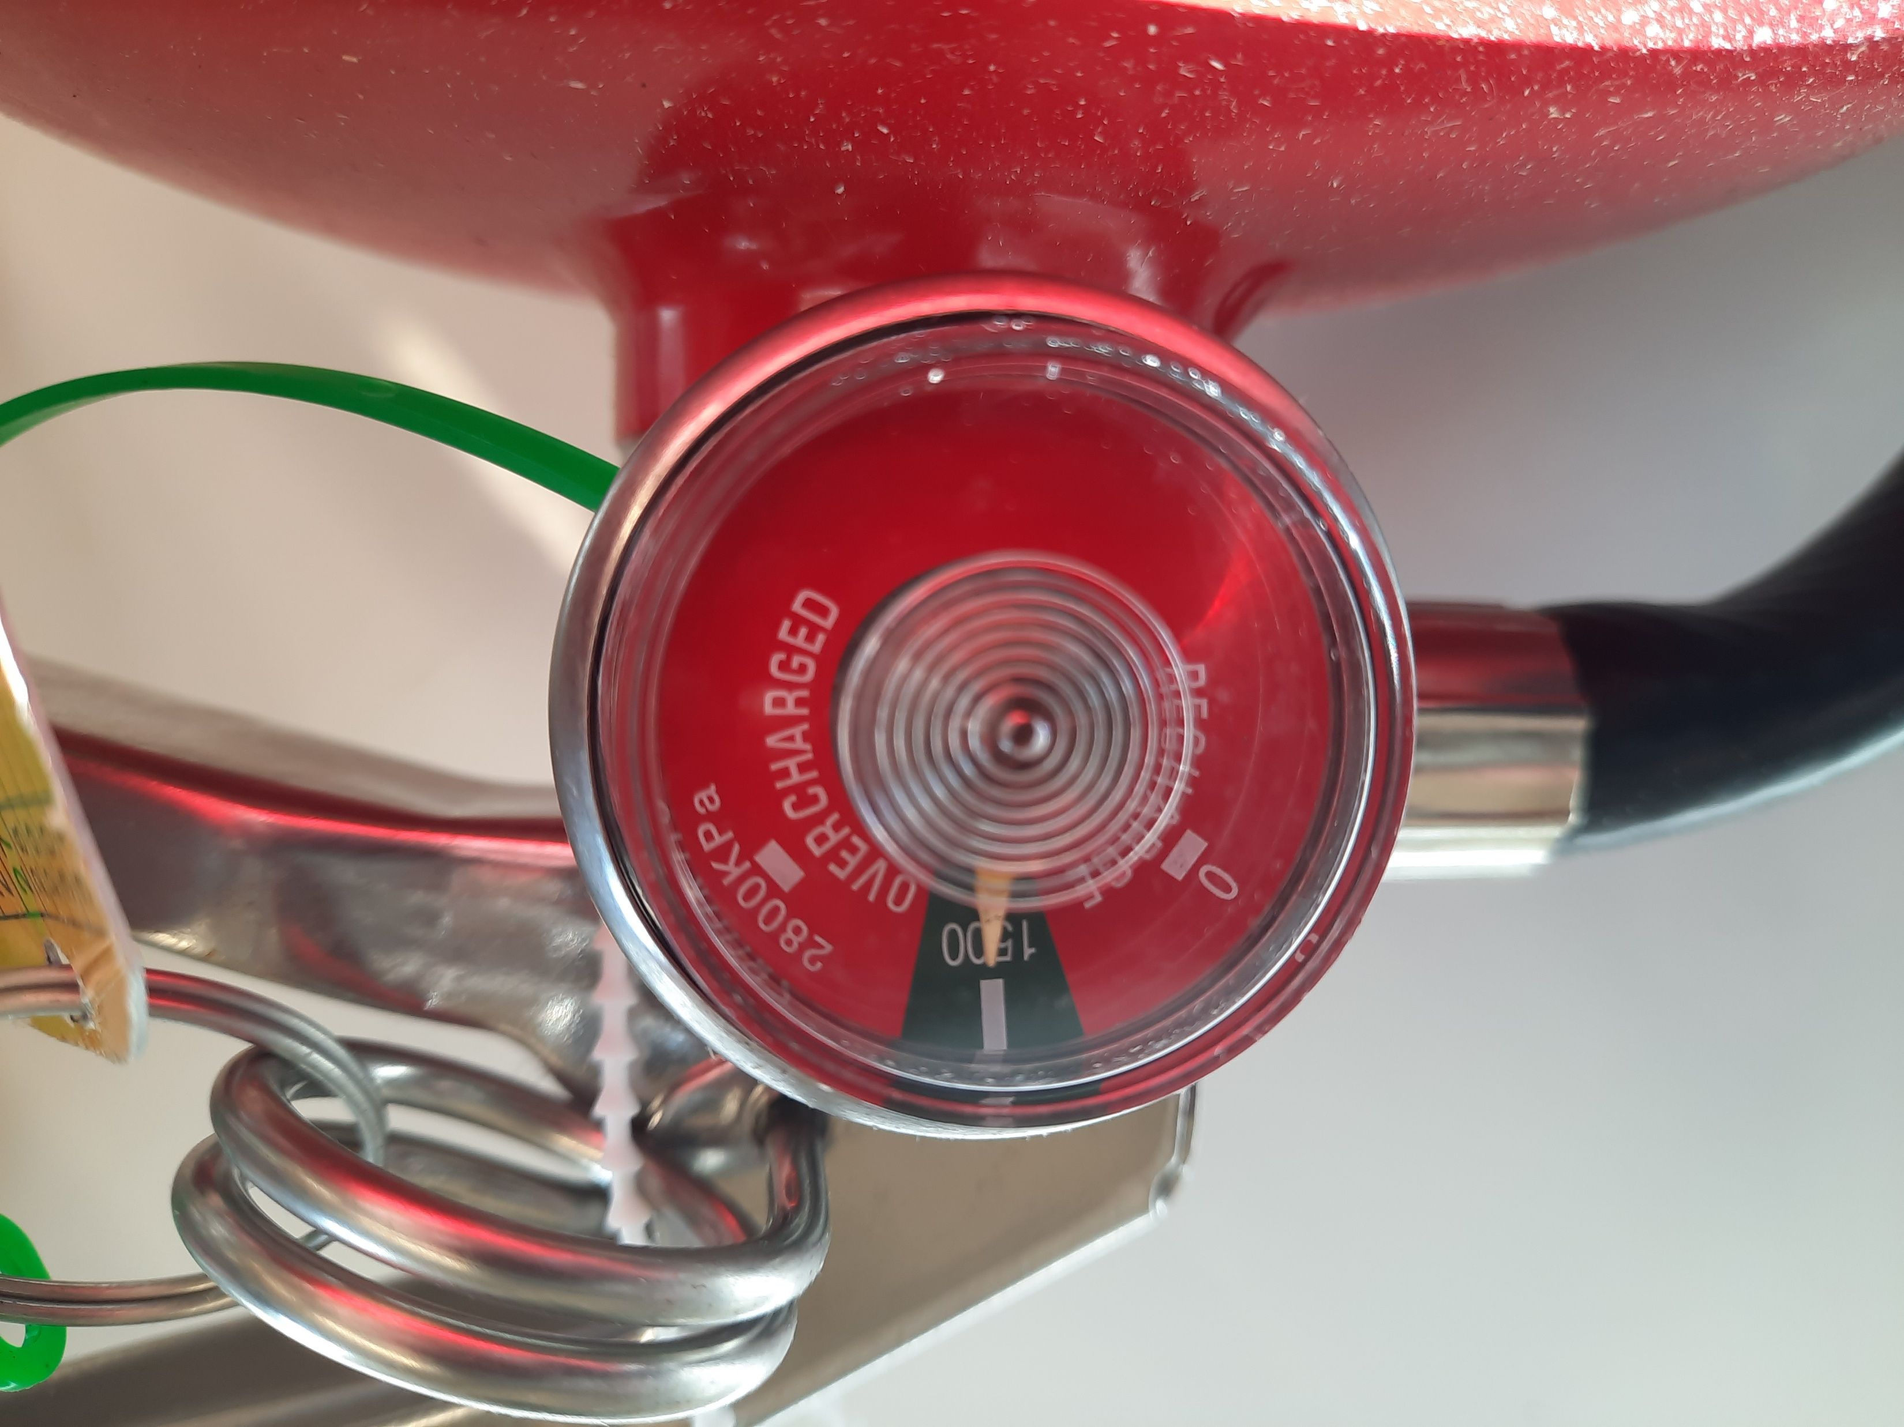
Checking the fire extinguisher

Slide 10
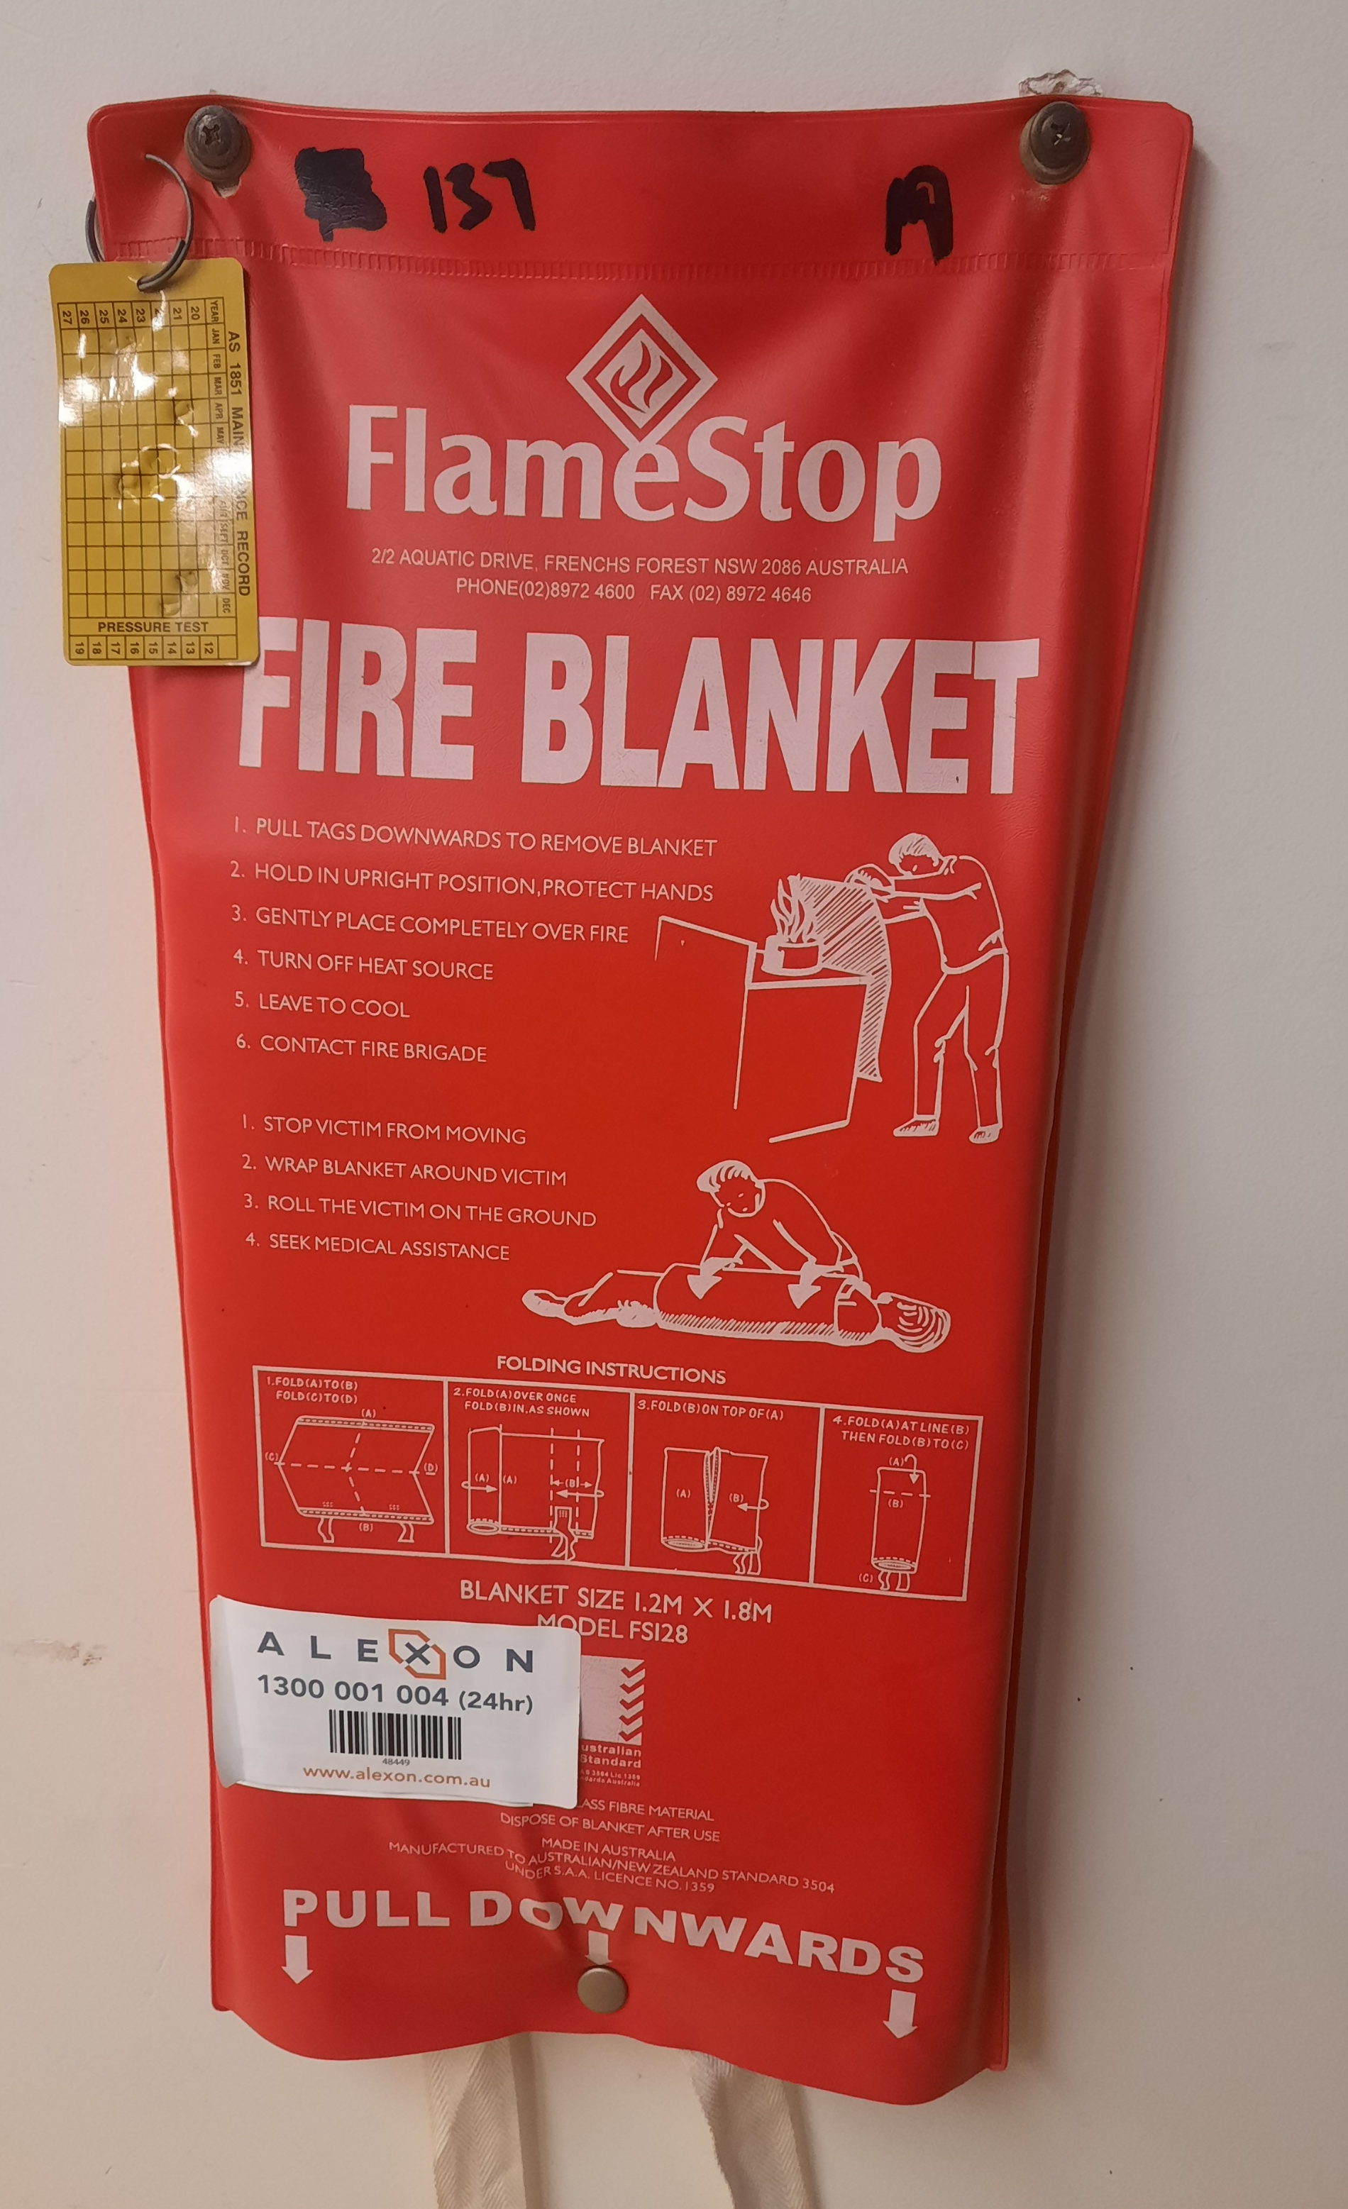
Fire blanket

Slide 11
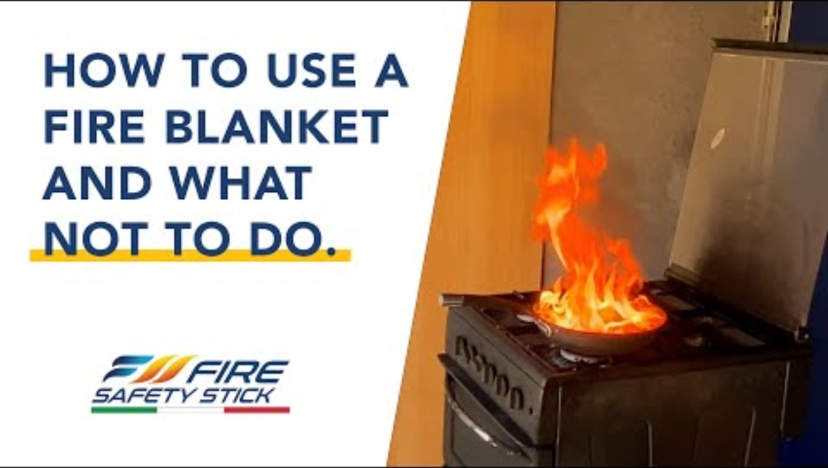
How to use a fire blanket https://www.youtube.com/watch?v=73uBTHEdew8

Slide 12
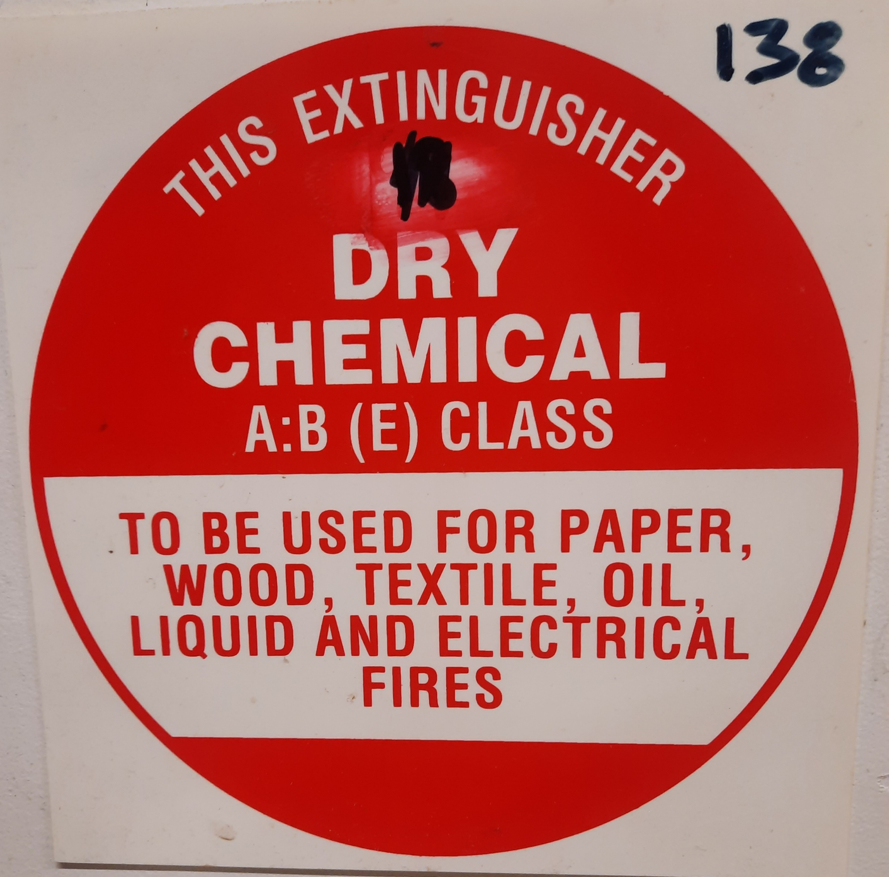
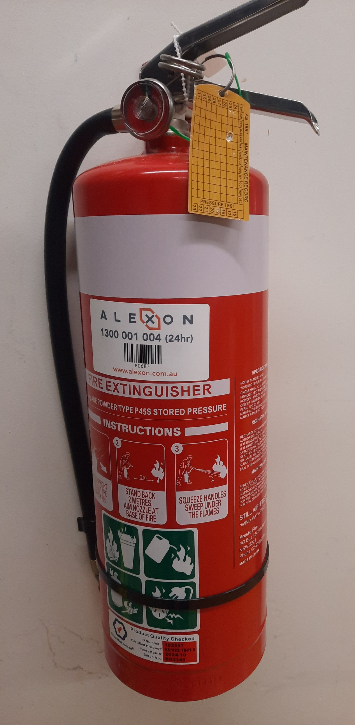
Type of fire extinguisher

Slide 13
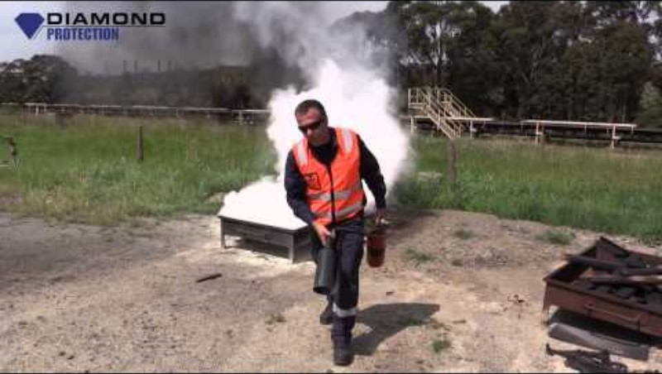

Slide 14
https://www.youtube.com/watch?v=k5HNHUGCFZw

Slide 15
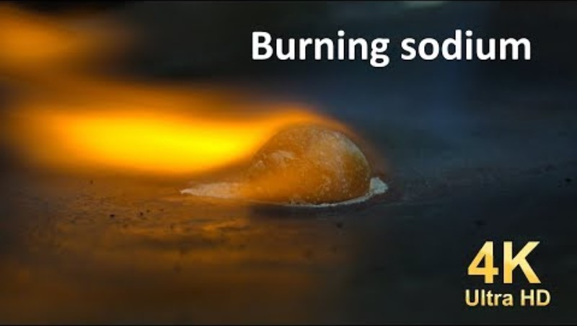

Slide 16
https://www.youtube.com/watch?v=QhBpjSJhD5s

Slide 17
How to treat metal fire?
To deal with sodium fires you need to remove the oxygen or cool.
CO2 and water extinguishers are not suitable and can be dangerous.
Dry powder agents like sand, soda ash, or a Class D extinguisher are suitable

Slide 18
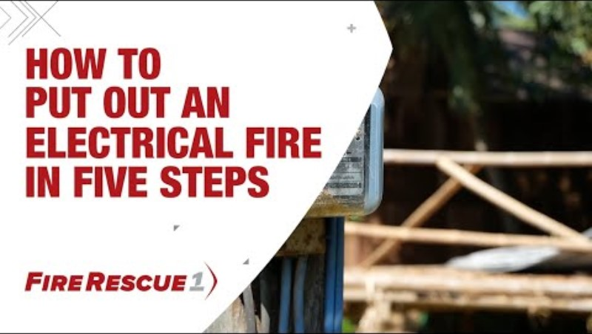

Slide 19
https://www.firerescue1.com/community-risk-reduction/articles/how-to-put-out-an-electrical-fire-in-five-steps-XB6EB1XTsNyKWkAN/

Slide 20
Dealing with gas fire
Steps
Shut off the gas supply at the shut-off valve if you can safely reach it. Turn the valve all the way to the right to close it. ...
Evacuate the building in case of any gas leaks. ...
Call the utility company immediately to have them shut off the gas supply. ...
Call the fire department to come and inspect the premises.

Slide 21
Science Assist
SOP – Use of fire extinguishers
Example risk assessment – Use of fire extinguishers
Customisable risk assessment – Use of fire extinguishers
SOP – Fire Blankets
Example risk assessment – Fire blankets
Customisable risk assessment – Fire blankets

