Slide 1
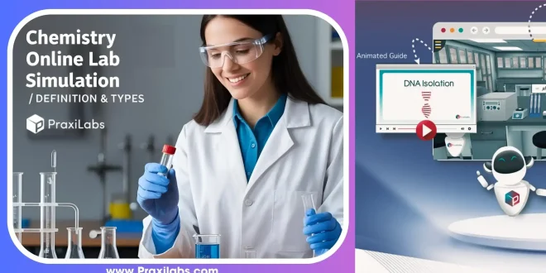
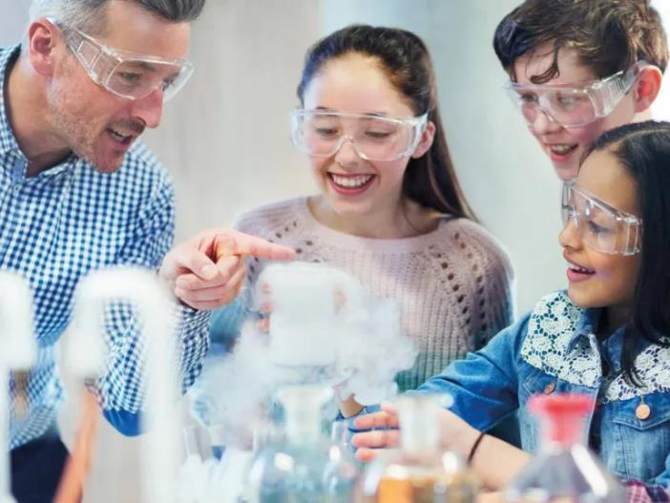
Face to Face V Online Demonstrations – what works best
Dr Jeff Hughes RMIT

Slide 2
“Face-to-face chemical demonstrations offer benefits like improved hands-on learning and direct instructor feedback, but online methods are safer for dangerous reactions, more cost-effective, and can visually represent abstract concepts that are hard to see in person. Online demonstrations can be particularly effective for reinforcing concepts and providing flexible learning opportunities, while many students still value the direct, hands-on experience of in-person labs”

Slide 3

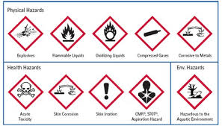
Online Demonstration
Youtube a Great resource!!
Why use online demonstrations?
Safety!!
Venue issues
Equipment availability
Cost

Slide 4
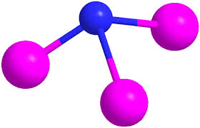
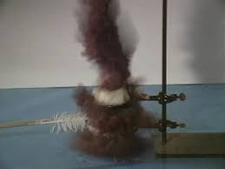
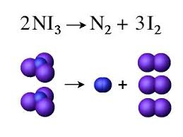
Example: Touchpowder
Touchpowder (nitrogen triiodide) very easy to make, readily available ingredients (Iodine and ammonia) but extremely shock sensitive
https://www.reddit.com/r/chemicalreactiongifs/comments/23dabj/nitrogen_triiodide_detonation_now_this_time_with/
Would you do this experiment in your lab?

Slide 5
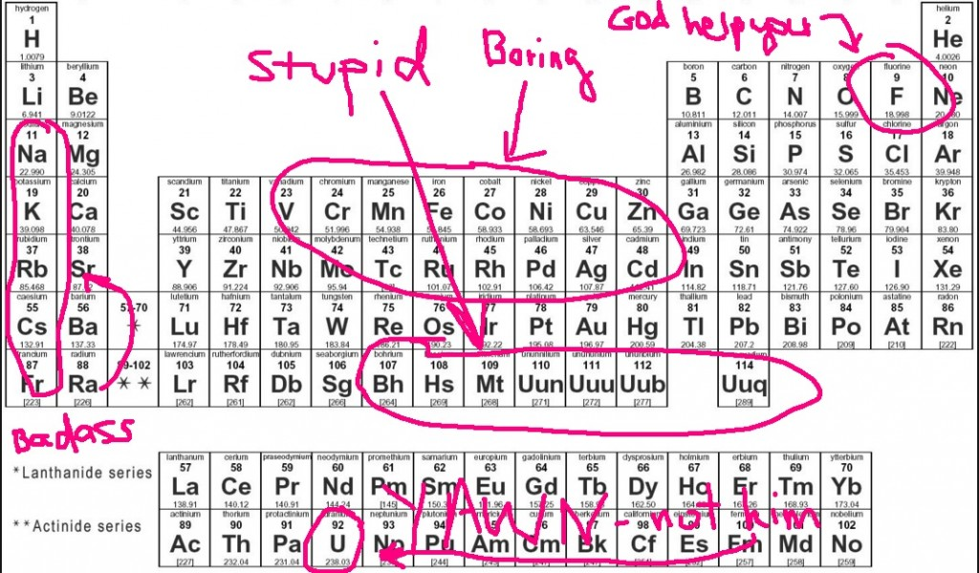
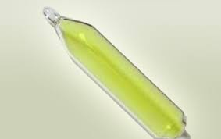
Fluorine – Element from Hell
Most dangerous non-radioactive element in periodic table

Slide 6
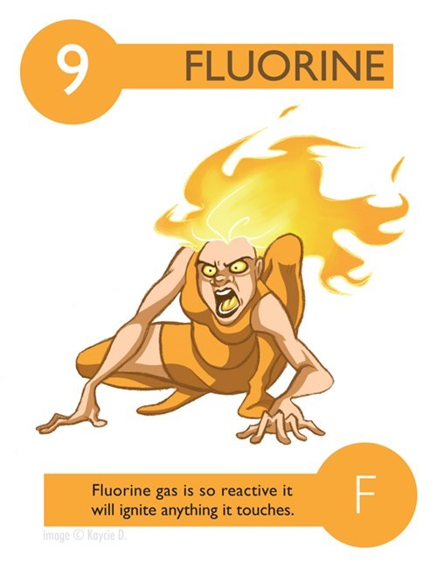
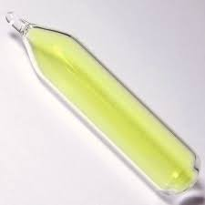
It reacts with virtually every element except Ar, He, and Ne.
It is lethal at very low levels.
Fire fighting The only practical way to extinguish a fluorine fire is to shut off the source of fluorine.
Water and CO2 fire extinguishers only add fuel to fire.
F2 is one of the most hazardous substances found in MSTD* laboratories.
* Materials Science and Technology Division, Oak Ridge National Laboratory If that doesn't make you feel safe enough, another booklet tells you how to protect yourself from it. Doesn't sound all that bad:

Slide 7
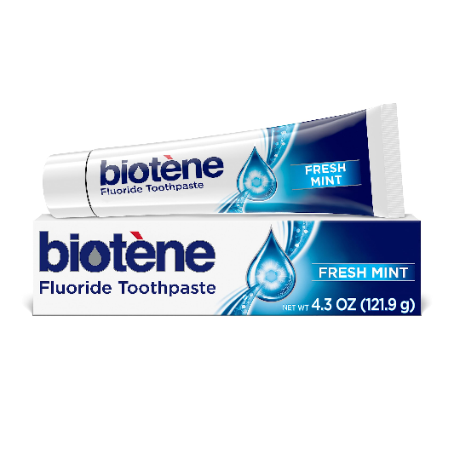
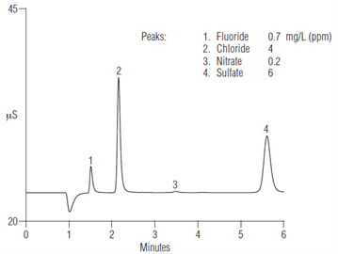
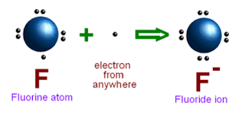
If fluorine is so dangerous why do we put it in our drinking water and toothpaste?
Tooth enamel:
Calcium Fluoroapatite

Slide 8
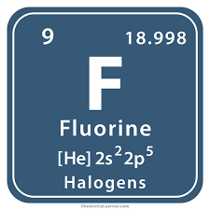
Fluorine
Periodic Table of Videos (Martyn Poliakoff)
http://www.periodicvideos.com/videos/009.htm
Light Bulb in Hydrofluoric Acid
https://www.youtube.com/watch?v=aZpA1k-sDcg

Slide 9
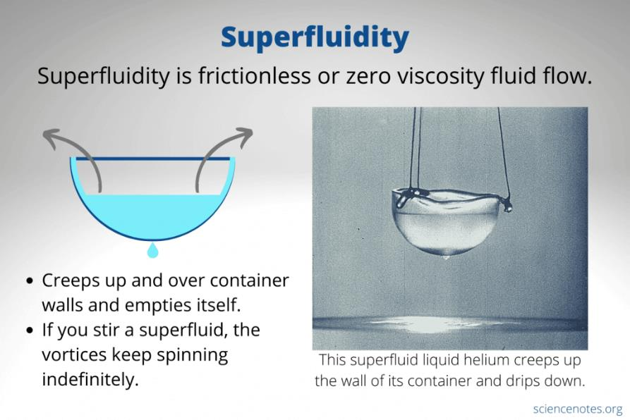
Helium near Absolute Zero
Helium does not liquefy till 5K (-268oC) but if is cooled further a new state is achieved, ‘supercooled helium’, and its properties are very odd indeed.

Slide 10
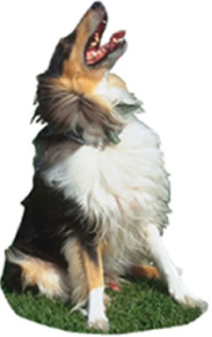
The Barking Dog
3NO + CS₂ => 1.5N₂ + CO + SO₂ + 1/8S₈
4NO + CS₂ => 2N₂ + CO₂ + SO₂ + 1/8S₈
The reaction produces considerable amounts of very bright blue light
One of the very few examples of chemiluminescence in the gas phase

Slide 11
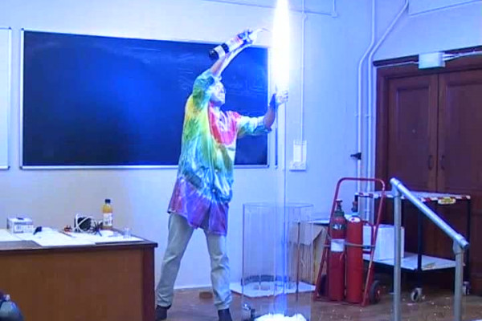
Liebig’s Demonstration
Liebig carried out the demonstration for the Bavarian royal family in 1853
There was a violent explosion and the Queen was wounded in the cheek
Liebig was saved from death by his use of a recreational drug!

Slide 12
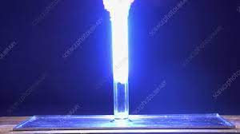
Liebig’s Demonstration
His snuff box prevented a large splinter of glass from penetrating his femoral artery
The explosion was probably due to presence of oxygen which created some NO₂
Can be prevented by having some water present
Demonstration of the Barking Dog

Slide 13
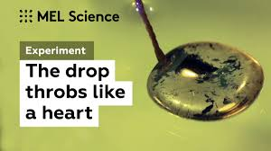
The Beating Heart
https://www.youtube.com/watch?v=m6631u7d4E0

Slide 14
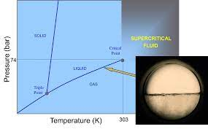
Martin Poliakoff has set up this demonstration of supercritical fluid in his office – it beats most desktop toys!!
Supercritical Fluid demonstration
Great face-to-face if you have the equipment!

Slide 15

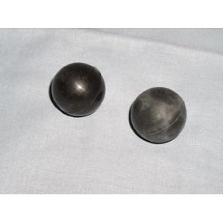
“Happy” and “Sad” Balls
Demonstrations which work better face-to-face
They are made of two different materials: Polychloropene (trade name Neoprene) and Polynorbornene (trade name Norsorex).

Slide 16
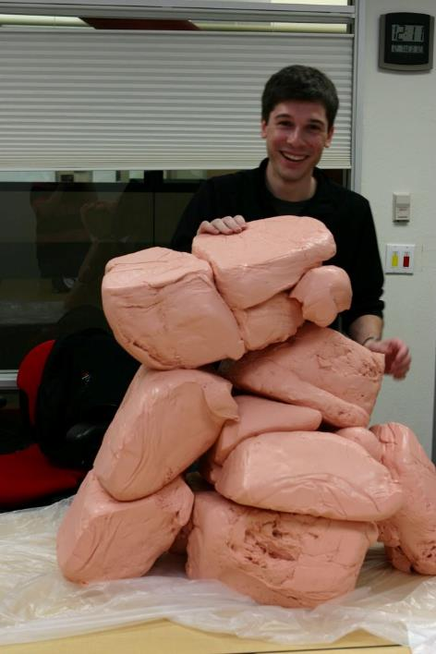

Silly Putty and Slime

Slide 17
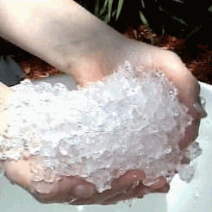
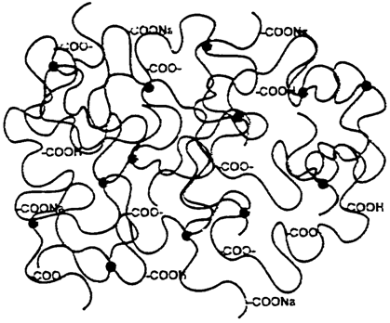
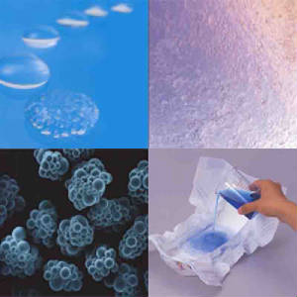
Super Absorbent Polymer

Slide 18
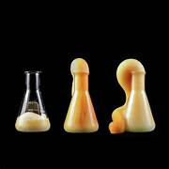
Elephant’s Toothpaste
https://www.youtube.com/watch?v=p1eG2y2mn54
Can be done face-to-face but messy
Best done in a lab

Slide 19
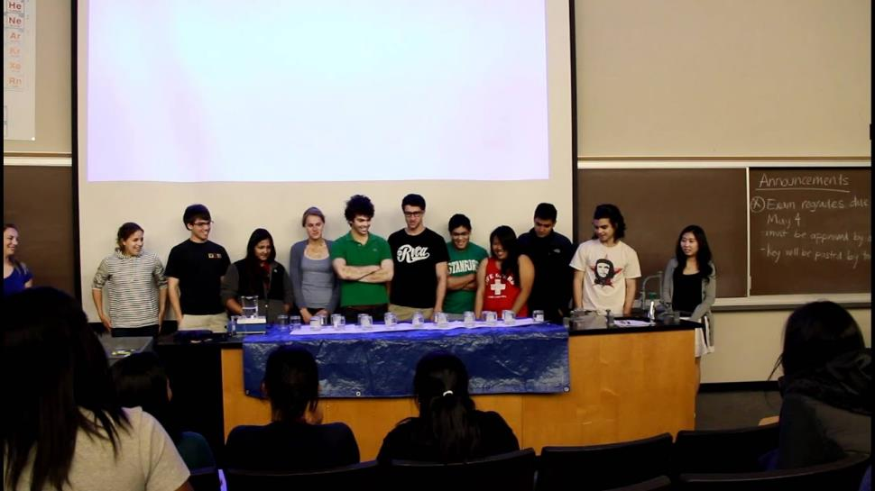
William Tell Overture
William Tell Overture Clock Reaction at Stanford
Quite safe to do but takes a LOT of setting up

Slide 20
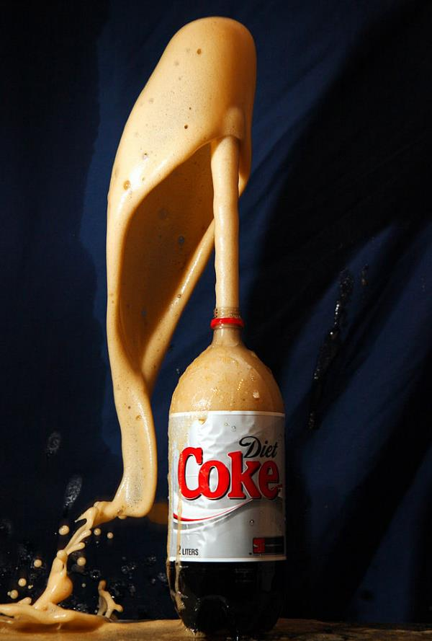
Mentos Dominoes
This demonstration has been around for some time but this is a special version –
A twist to the ‘domino effect’
Not dangerous but very messy!
Some people have way too much time on their hands!
This version takes a LOT of time to set up (+ a lot of Pepsi)

Slide 21
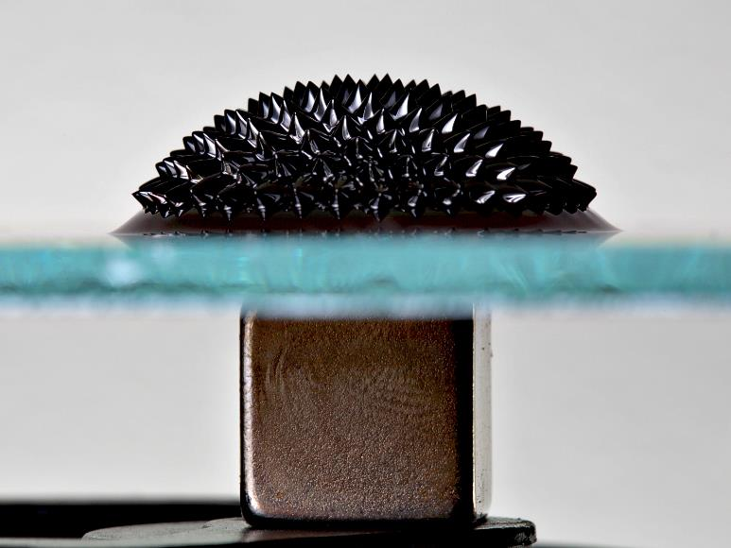
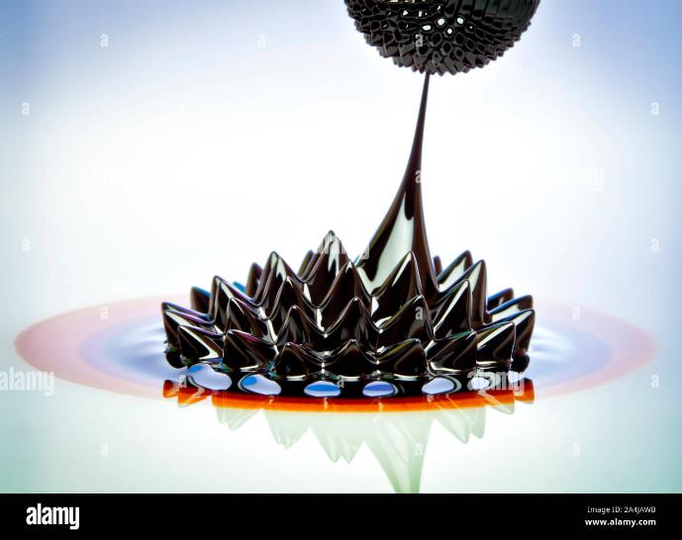
Ferrofluid
This very unusual substance has become quite a hit on YouTube.
Safe but messy – needs to keep ferrofluid sealed up

Slide 22
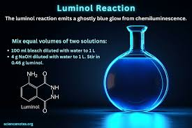
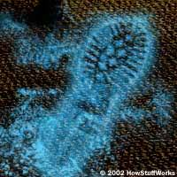
Luminol
https://www.youtube.com/watch?v=O99_0DyHNQI
Bloodstains
https://www.youtube.com/watch?v=w9TAs6jjykA

Slide 23
Resources
Periodic Table of Videos
http://www.periodicvideos.com/
Chemical Curiosities: Surprising Science and Dramatic Demonstrations - with Chris Bishop – a really good series of demonstrations
https://www.youtube.com/watch?v=ti_E2ZKZpC4

