Slide 1
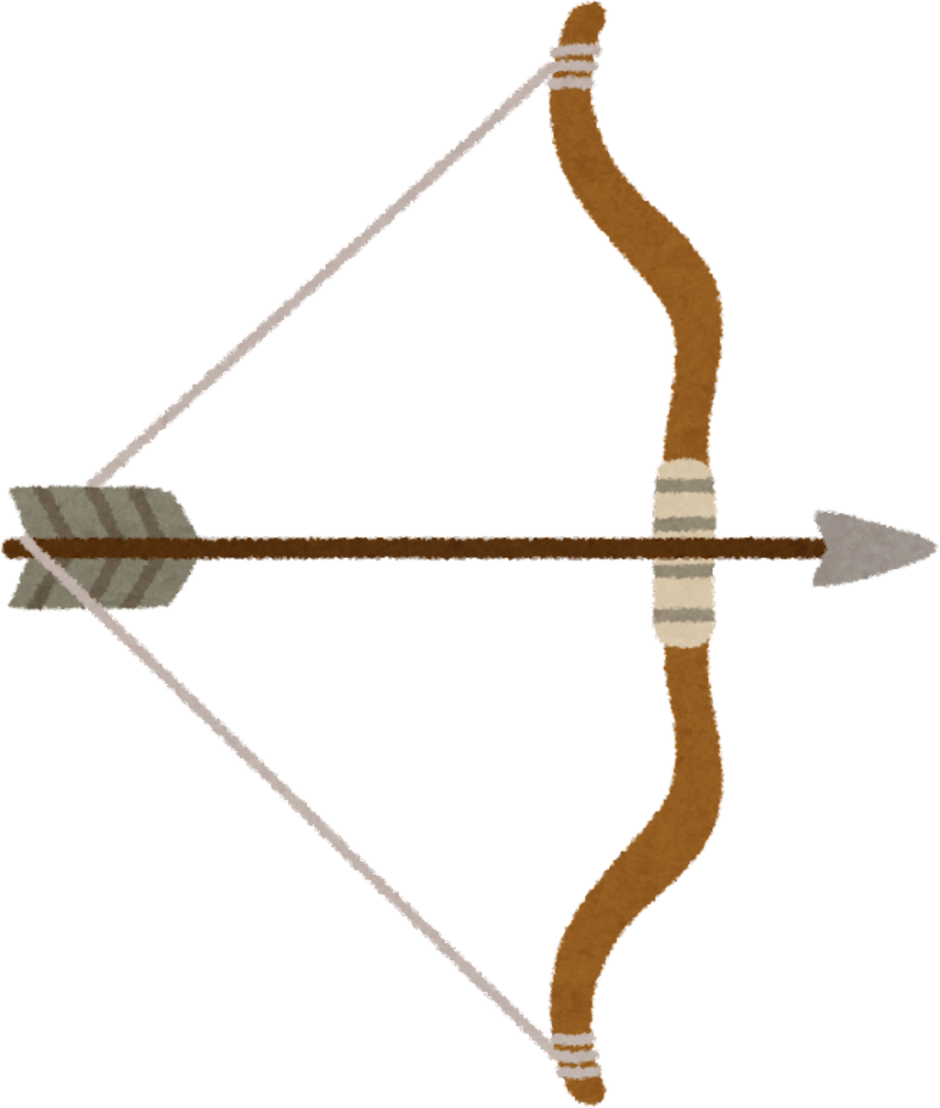
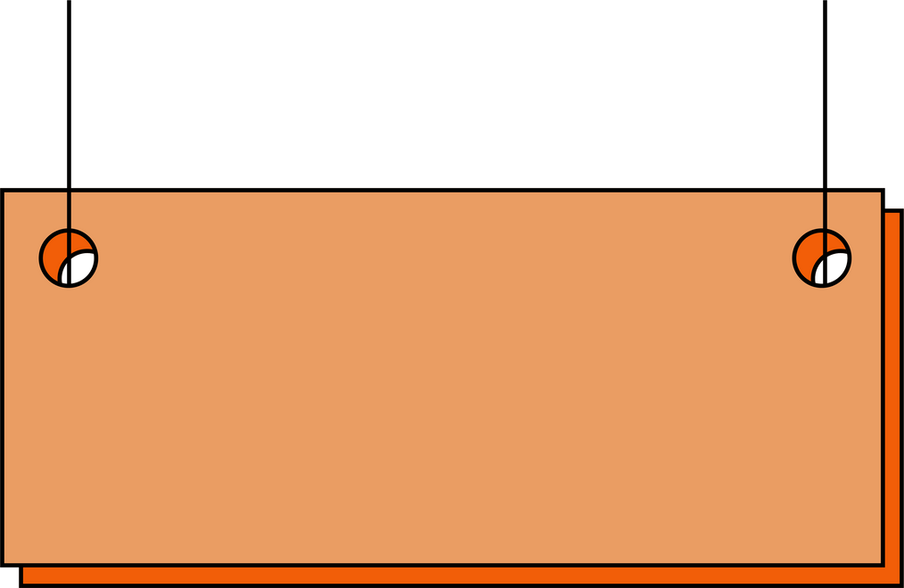
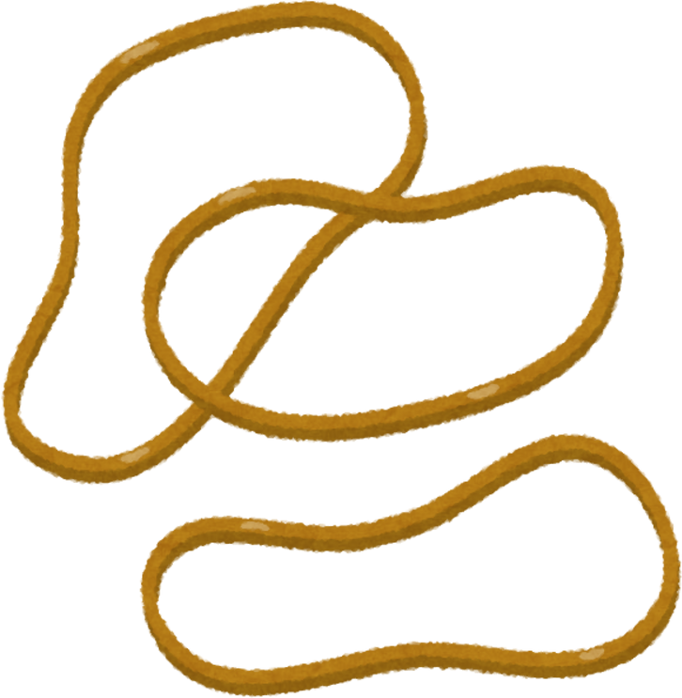


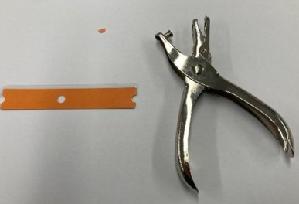
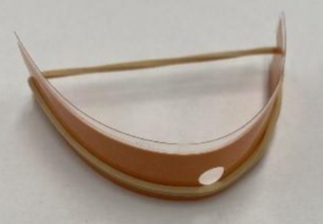


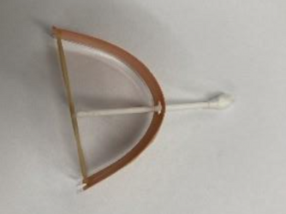


HOW TO MAKE MINI BOW AND ARROWS
METHOD:
Take your strip of coloured laminate and using the hole puncher cut a half circle on either side as shown.
IMPORTANT NOTE:
DO NOT TAKE THE RUBBER BAND AND Q-TIP AWAY!!
2. Wrap the rubber band around the laminated piece of paper (don't cover the hole!)
3. Take the Q-tip and put it through the hole, hold the rubber band and the end of the Q-tip and shoot!
STEAM

