Slide 1
LABCON 2015 How will Victorian science curriculum changes affect the work of laboratory technicians? 2-3 December 2015
Maria James
Victorian Curriculum and Assessment Authority

Slide 2
© Victorian Curriculum and Assessment Authority 2015
Third parties may own copyright in some content included in this presentation, as indicated.
The term VCE and associated logos are registered trademarks of the VCAA.
VCAA content may be used in accordance with the VCAA’s Intellectual Property and Copyright Policy:
http://www.vcaa.vic.edu.au/Pages/aboutus/policies/policy-copyright.aspx

Slide 3
Workshop aims
Provide an overview about the changes to the:
F-10 Victorian Curriculum
VCE science study designs
Consider how the changes can be managed effectively in a school
Respond to audience questions

Slide 4
Demands on lab techs
Hey, Deb… I’ve just decided to start a new unit tomorrow morning Period 1…can you prepare 15 ripple tanks, 7 light boxes, 4 litres of 0.5 M sulfuric acid and a set of 20 agar plates, please?... And for Period 2…
Thinks:*#&* !!!!…
Says: …No worries, Maria…
Thinks: don’t they teach these teachers anything about time management at university?)

Slide 5
Victorian Curriculum F-10
Released in September 2015 as a central component of Education State, Victorian Curriculum F-10
provides a stable foundation for whole schooling curriculum and assessment planning
incorporates the Australian Curriculum
reflects Victorian standards and priorities

Slide 6
Evolution of Victorian Curriculum
Frameworks
CSF
CSF II
VELS
AusVELS
Victorian Curriculum
IB
Reggio Emilia
Australian Curriculum
Montessori
International curriculum frameworks

Slide 7
Timelines
Implementation of the new Victorian Curriculum can commence in individual schools as soon as they choose, with all schools required to implement the new curriculum from the start of 2017. In other words, schools will have the remainder of 2015 and all of 2016 to prepare for full implementation in 2017.
2015-16 | From 2015
AusVELS curriculum available AusVELS website archived December 2016 | Victorian Curriculum available Full implementation from 2017

Slide 8
Victorian education priorities
There is important content that every young Victorian should learn. This includes:
Australia’s system of government, history and cultures, including Aboriginal and Torres Strait Islander histories and cultures
the values of democracy, equity and justice, including reconciliation between Indigenous and non-Indigenous Australians
high levels of enabling skills in English literacy and numeracy
a broad knowledge and understanding of the importance of the STEM (Science, Technology, Engineering and Mathematics), Humanities and Arts disciplines
the knowledge and skills necessary for participation in a digital world
knowledge of how wellbeing and safety can be protected and nurtured
attributes central to participation in the contemporary economy and for civic participation such as creativity and innovation, critical thinking, problem-solving, and learning to learn

Slide 9
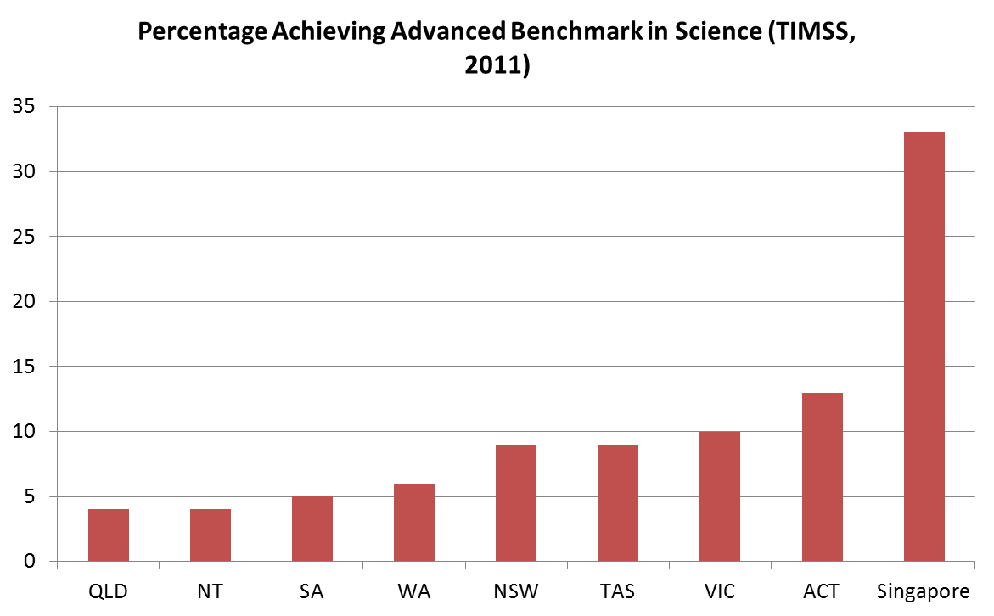
Imperatives
Improving performance in top levels (Griffin)
Enabling targeted teaching (Grattan Institute and Masters)
Clearer focus on essential content across the curriculum (Marzano)
Middle school innovation through flexible curriculum delivery
Strengthening explicit learning in capabilities (Griffin)

Slide 10
Design and structure
Learning areas | Capabilities
English | Critical and creative thinking
Mathematics | Personal and social capability
Science | Intercultural capability
Health and physical education | Ethical capability
Humanities and social sciences (History, Geography, Civics and citizenship; Business and economics)
Languages
The Arts
Technologies (Design and Digital Technologies)
The Victorian Curriculum F-10 is based on eight learning areas and four capabilities

Slide 11
Why ‘capabilities’?
Australian curriculum ‘general capabilities’:
‘general capabilities’ act as ‘enablers’ for other learning areas
no achievement standards
Victorian curriculum ‘capabilities’:
- treated as areas of learning in their own right and hence they are reported on
- achievement standards written to enable reporting
Discuss: How will the teaching of capabilities in science classes affect the work of laboratory technicians?

Slide 12
Would you eat a doggieburger?
French news sources from the late 19th century carried stories reporting lines of people buying dog meat, which was described as being "beautiful and light."
It is thought to have medicinal properties, and is especially popular in winter months in northern China, as it is believed to raise body temperature after consumption and promote warmth
It is legal to eat dogs in most States and Territories, except for South Australia. However, it is illegal to sell dog meat for human consumption in any Australian State or Territory

Slide 13
Activity: Capabilities
Opportunities for students to develop capabilities should be included in planning learning activities, such as in the example below.
Plan: Choose a year level and discuss how the capabilities can be incorporated into questions about food choices.
Ethical understanding
Science curriculum context examples: ethics of eating meat; laboratory-grown versus organically-grown meat
Critical and creative thinking
Science curriculum context examples: nutritional analysis; species depletion
Would you eat a doggieburger?
Personal and social capability
Science curriculum context examples: factors influencing decision-making and choice
Intercultural understanding Science curriculum context examples: cultural taboos; distribution of species globally; environmental conditions favouring animal survival

Slide 14
One approach to whole-school planning
Extra-curricular program
School ethos
Whole school planning
Capabilities
Critical and creative thinking
Ethical capability
Intercultural capability
Personal and social capability
*Specific learning area mapping:
Identify which elements of each capability is:
important for enhancing learning in the area
moderately important
irrelevant
*Note: combining mapping for all 8 learning areas should ensure coverage of all elements of the capabilities

Slide 15
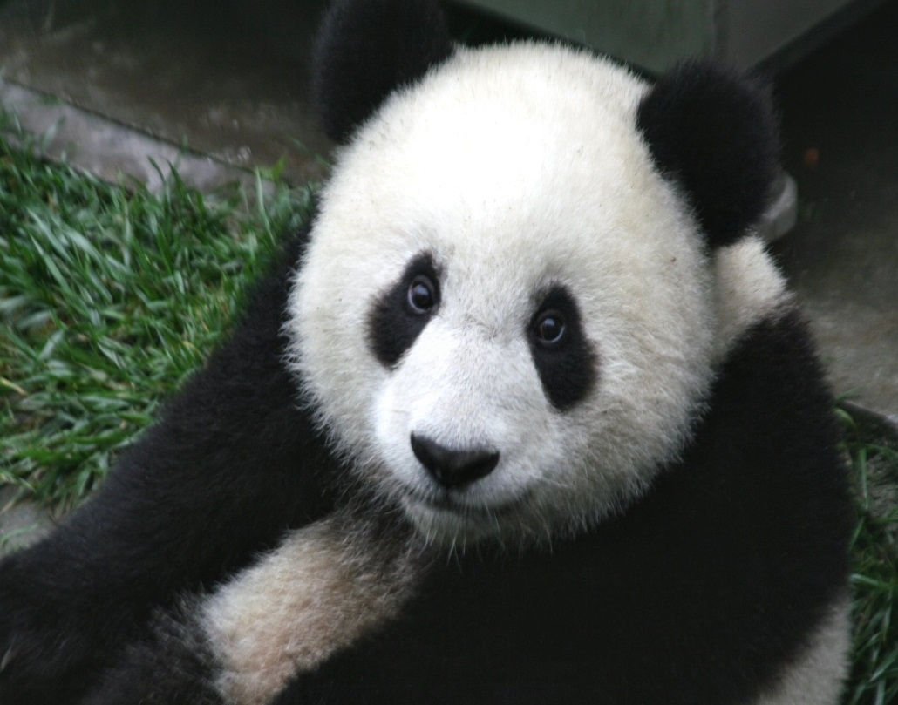
Both of these animals are endangered – which would you rather save?
A purple pig-nosed frog
A giant panda

Slide 16
‘Ugly’ frog or ‘cute’ panda?
Significant public funding and research is allocated to protecting and conserving species, for example the Giant panda. In 2014, there were 2464 animals with an assessment of “critically endangered” (compared with 1998 levels of 854). How are species selected as targets for conservation?
Activities:
Critical thinking: discuss cases where species have been supported by public funding and/or research and consider, “How does being ‘cute’ or ‘ugly’ affect the survival chances of a species?”
Creative thinking: select an ‘ugly’ threatened animal and prepare an advertising campaign (TV advertisement; poster; pamphlet) to promote the case for its conservation.
Ethical capability: How are school ‘social service’ projects selected? Who selects them? How can ‘new’ social service projects be initiated?

Slide 17
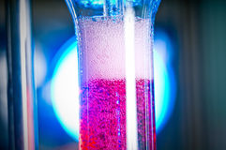
The music of chemistry
Task: Students take time-lapse images of a chemical reaction involving visible changes and present a slow-motion sequence of the chemical change accompanied by selected music that focuses on important aspects of the change
Discussion: What is the role of the laboratory technician in assisting students to complete this task?
Visible evidence of a chemical reaction: colour change; production of a gas
Other sensory observations: energy change; odour production

Slide 18
Science curriculum structure
Australian Curriculum and AusVELS Science |  |  | Victorian Curriculum Science
Strand | Sub-strand |  | Strand | Sub-strand
Science Understanding | Biological sciences |  | Science Understanding | Science as a human endeavour
 | Chemical sciences
 |  |  |  | Biological sciences
 | Earth and space sciences |  |  | Chemical sciences
 | Physical sciences |  |  | Earth and space sciences
Science as a Human Endeavour | Nature and development of science |  |  | Physical sciences
 | Use and influence of science
 |  |  | Science Inquiry Skills | Questioning and predicting
Science Inquiry Skills | Questioning and predicting
 |  |  |  | Planning and conducting
 | Planning and conducting
 |  |  |  | Recording and processing
 | Processing and analysing data and information
 |  |  |  | Analysing and evaluating
 | Evaluating |  |  | Communicating
 | Communicating

Slide 19
Sequencing scientific skills
The development of scientific skills can be mapped as a continuum, for example, the measurement and recording of data:
Levels F-2 | Levels 3&4 | Levels 5&6 | Levels 7&8 | Levels 9&10
Use informal measurements in the collection and recording of observations | Use formal measurements in the collection and recording of observations | Construct and use a range of representations, including tables and graphs, to record, represent and describe observations, patterns or relationships in data | Construct and use a range of representations …to record and summarise data from students’ own investigations …, and to represent and analyse patterns and relationships | Construct and use a range of representations … to record and summarise data…, to represent qualitative and quantitative relationships in data, and distinguish between discrete and continuous data
Use a range of methods, including… provided tables to sort information | Use a range of methods including… column graphs to represent data and identify patterns…

Slide 20
Science skills F-12 continuum
Victorian Curriculum Science Inquiry Skills | VCE key science skills
Questioning and predicting | Develop aims and questions, formulate hypotheses and make predictions
Planning and conducting | Plan and undertake investigations Comply with safety and ethical guidelines Conduct investigations to collect and record data
Recording and processing | Conduct investigations to collect and record data
Analysing and evaluating | Analyse and evaluate data, methods and scientific models Draw evidence-based conclusions
Communicating | Communicate and explain scientific ideas

Slide 21
Activity: Is paw size related to height?
The Victorian Curriculum provides numerous opportunities for the development of numeracy and literacy skills, as illustrated in this activity:
Discuss:
How would you investigate this question in level-appropriate ways?
How will data be collected in level-appropriate ways by students?
What level of assistance will be provided for students?
How will data be analysed and presented in level-appropriate ways?
“Paws for thought”

Slide 22
Activity: Do animals need clothing?
Scientific investigations
Developing questions and hypotheses that can be investigated scientifically is important in science.
Not all questions can be investigated scientifically
Various types of investigations can be used to investigate science-based questions
Activity: Work in groups to discuss how the question “Do animals need clothing?” can be investigated at different levels of schooling

Slide 23
F-10 Biological sciences changes
Level | AC/AusVELS content description | Victorian Curriculum content description
F-2 | F: Living things have basic needs, including food and water | Living things have a variety of external features and live in different places where their basic needs, including food, water and shelter, are met
 | 1&2: Living things have a variety of external features
 | 1&2: Living things live in different places where their needs are met
 | 1&2: Living things grow, change and have offspring similar to themselves | Living things grow, change and have offspring similar to themselves
3&4 | Living things have life cycles | Different living things have different life cycles and depend on each other and the environment to survive
 | Living things, including plants and animals, depend on each other and the environment to survive
9&10 |  | An animal's response to a stimulus is coordinated by its central nervous system (brain and spinal cord); neurons transmit electrical impulses, and are connected by synapses

Slide 24
F-10 Chemical sciences changes
Level | AC/AusVELS content description | Victorian Curriculum content description
F-2 | F: Objects are made of materials that have observable properties | Objects are made of materials that have observable properties
 | 1&2: Everyday materials can be physically changed in a variety of ways | Everyday materials can be physically changed or combined with other materials in a variety of ways for particular purposes
 | 1&2: Different materials can be combined, including by mixing, for a particular purpose
3&4 | Solids, liquids and gases have different observable properties and behave in different ways | Solids, liquids and gases behave in different ways and have different observable properties that help us to classify them
 | Changes to materials can be reversible, such as melting, freezing, evaporating; or irreversible, such as burning and rusting | Changes to materials can be reversible, including melting, freezing, evaporating; or irreversible, including burning and rusting
7&8 | Differences between elements, compounds and mixtures can be described at a particle level | Differences between elements, compounds and mixtures can be described by using a particle model
9&10 | Different types of chemical reactions are used to produce a range of products and can occur at different rates | Different types of chemical reactions are used to produce a range of products and can occur at different rates; chemical reactions can be represented by balanced chemical equations

Slide 25
F-10 Physical sciences changes (Levels 3-8)
Level | AC/AusVELS content description | Victorian Curriculum content description
3&4 | 3: Heat can be produced in many ways and can move from one object to another | Heat can be produced in many ways and can move from one object to another; a change in the temperature of an object is related to the gain or loss of heat by the object
5&6 | 6: Electrical circuits provide a means of transferring and transforming electricity | Energy from a variety of sources can be used to generate electricity; electric circuits enable this energy to be transferred to another place and then to be transformed into another form of energy
 | 6: Energy from a variety of sources can be used to generate electricity
7&8 | 8: Energy appears in different forms including movement (kinetic energy), heat and potential energy, and causes change within systems | Energy appears in different forms including movement (kinetic energy), heat, light, chemical energy and potential energy; devices can change energy from one form to another
 |  | Light can form images using the reflective feature of curved mirrors and the refractive feature of lenses, and can disperse to produce a spectrum, which is part of a larger spectrum of radiation
 |  | The properties of sound can be explained by a wave model

Slide 26
F-10 Physical sciences changes (Levels 9-10)
Level | AusVELS content description | Victorian Curriculum content description
9&10 | 9: Energy transfer through different mediums can be explained using wave and particle models | Electric circuits can be designed for diverse purposes using different components; the operation of the circuits can be explained by the concepts of voltage and current
 |  | The interaction of magnets can be explained by a field model; magnets are used in the generation of electricity and the operation of electric motors
 | 10: Energy conservation in a system can be explained by describing energy transfers and transformations | Energy flow in Earth's atmosphere can be explained by the processes of heat transfer
 | 10: The motion of objects can be described and predicted using the laws of physics | The description and explanation of the motion of objects involves the interaction of forces and the exchange of energy and can be predicted using the laws of physics

Slide 27
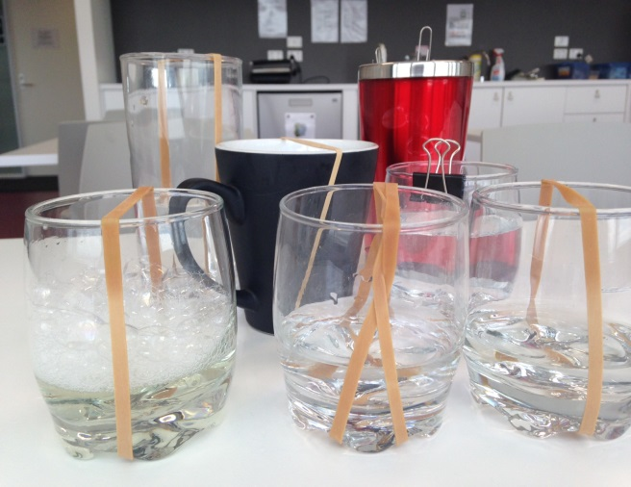
Primary school example: science links to music
Class concert
Students:
self-select to construct a wind, percussion or string instrument from household materials (empty or full food cans; bottles or jars; pots; pans; rubber bands; string; combs; hammers; cardboard tubes etc)
work in a ‘wind’, ‘percussion’ or ‘string’ group to test materials and the sounds they produce, sharing ideas and reflecting/ providing comments about each others’ findings, and to construct their own final instrument
form a ‘band’ of at least four members, name their group, select a nursery rhyme or folk song to play, and prepare for a class concert (may be presented to other F-2 classes, or as part of a parent/family night)
Set of student-constructed string instruments
Levels F-2 Science: Light and sound are produced by a range of sources and can be sensed
Levels 1&2 Music: Sing and play instruments to improvise, compose and practise a repertoire of chants, songs and rhymes, including those used by cultural groups in the local community

Slide 28
Secondary school example: science links to mathematics
The remains of a fossilised insect (minus two legs) was found in a sandstone formation in South-West Victoria.
Task: Identify possible classification orders to which the insect may belong by comparing the following body part ratios to those of known insect orders (head to total body; thorax to total body; abdomen to total body; head to thorax; head to abdomen; thorax to abdomen)
Levels 7&8 Science: There are differences within and between groups of organisms; classification helps organise this diversity
Level 7 Mathematics: recognise and solve problems involving simple ratios
Level 8 Mathematics: investigate terminating and recurring decimals
Is this a new insect?

Slide 29
Literacy, numeracy and ICT
The Science curriculum provides many opportunities for developing literacy, numeracy and ICT skills, as illustrated by the following three activities:
. Literacy: Levels 3 & 4 - use of a ‘heptaverse (seven-lined text) template’ can link or distinguish between two words, ideas or concepts – in this case, scientific vocabulary related to life cycles
. Numeracy: all Levels – measurement and concepts related to accuracy and precision involve development and application of numeracy skills
. ICT: all Levels – data from repeated trials and surveys can be collated, processed and sorted in order to draw evidence-based conclusions

Slide 30
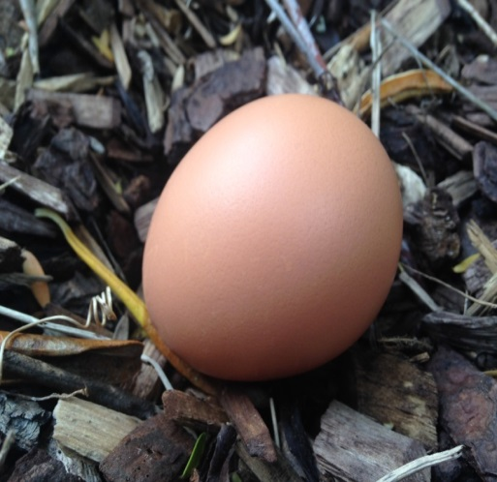
Exploring science language
The example below shows the use of a ‘heptaverse’ (seven-lined text) template to work with scientific vocabulary related to life cycles
Literacy applications
Line | Template | Student example
1 | What does the living thing start as? | egg
2 | Size /shape /colour of (line 1 object) | brown-speckled, oval
3 | Three things that (line 1 living thing) does (ending in “ing”) - description of where it does it and how it is done | resting, waiting, expecting – a twiggy nest protects
4 | How does (line 1 object) change into (line 7) object? | breaking through a cracked shell into a new world…
5 | Three things that (line 7 living thing) does (ending in “ing”) – description of where it does it and how it is done | stumbling, exploring, stretching – the fresh air welcomes
6 | Size /shape /colour of (line 7 living thing) | fluffy, yellow
7 | What does (line 1) become? | chicken

Slide 31
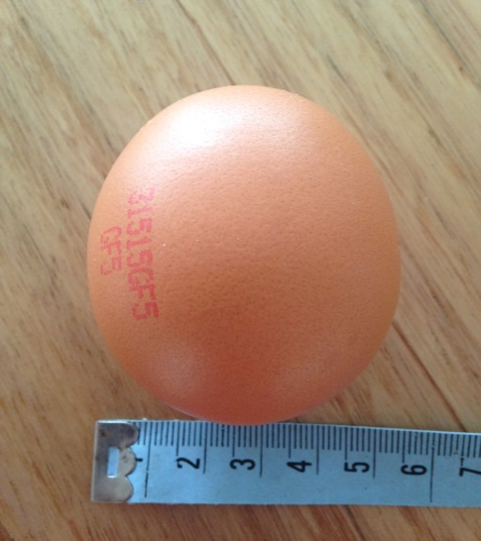
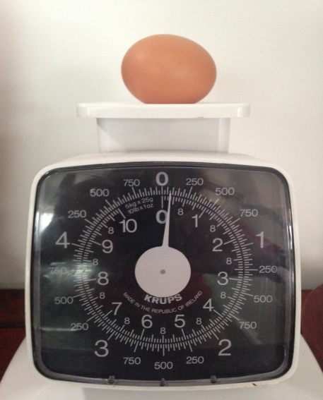
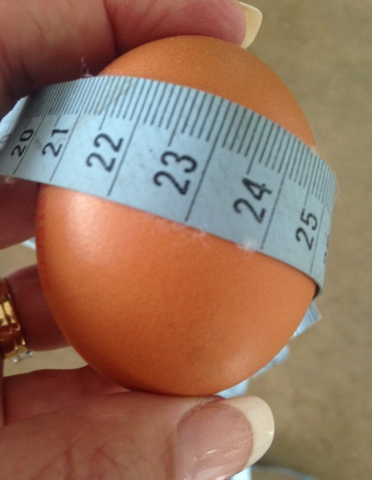
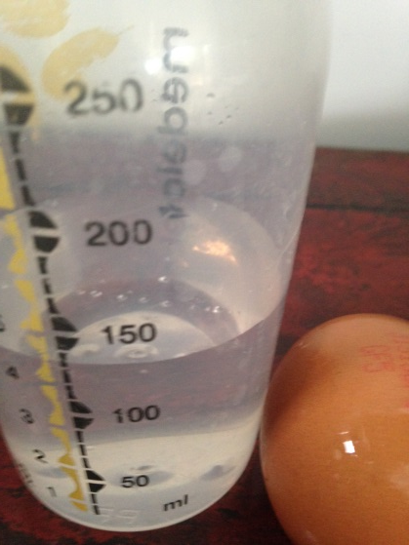
E(ggs)xactly!
Numeracy applications
Class comparisons of measures of length, width, mass and volume can be used to discuss measurement precision in addition to exploring relationships between quantities in one, two and three dimensions
Do eggs with larger circumferences crack more easily?
Use Archimedes’ principle to measure the volume of an egg
How do class measurements of an egg’s length and width compare?
What is the degree of precision of different weighing machines?

Slide 32
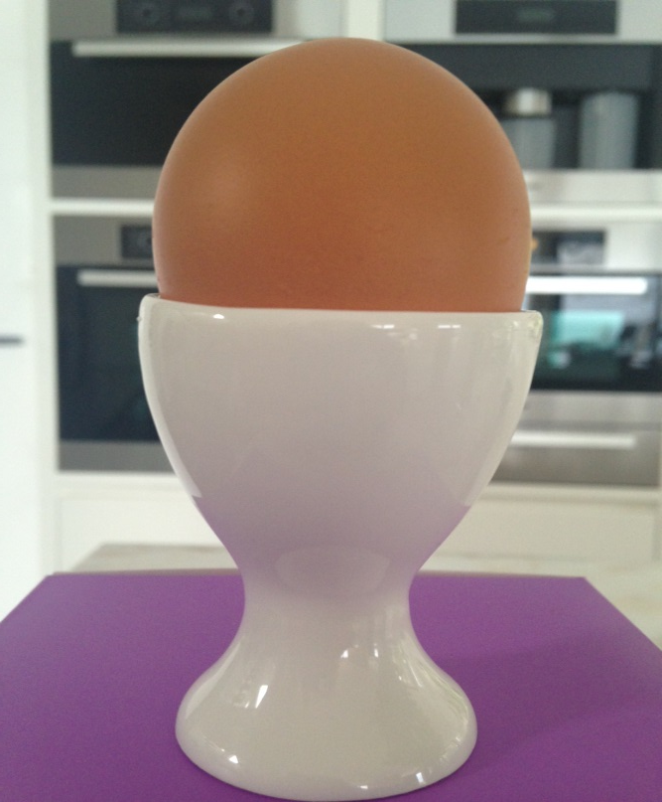
Are brown chooks better egg layers than white chooks?
ICT applications
ICT can be used to generate, process and present scientific data and findings.
Discussion:
Data collected from surveys can be collated and processed using ICT to look for relationships. Identify the specific ICT skills required in order to respond to one of the three question posed about hens and eggs.
Does egg weight production by a single hen follow a normal distribution?
Do brown eggs taste better than white eggs?

Slide 33
Victorian science curriculum in summary
Single band for Foundation, Level 1 and Level 2
Levels 3 to 10 organised in two-year bands
Science as a human endeavour changed from being a strand in AusVELS to being a sub-strand of the Science Understanding strand in the Victorian Curriculum
Physical sciences sub-strand strengthened
Two of the five sub-strands in the Science Inquiry Skills strand have been reconfigured
Embedded literacy, numeracy, ICT and sustainability
Two science strands
Strand
Science Inquiry Skills
Disciplinary concepts and skills are explicit
Strand
Science Understanding
Science concepts are explicit within content descriptions
Achievement Standard
Achievement Standard
Progression of concepts and skills are aligned with the two science strands

Slide 34
F-10 Victorian Curriculum support
Phase 1: Professional learning for principals/ curriculum leaders
Phase 2: School-based planning
Phase 3: Professional learning in specialist areas
Discussion: How is professional learning for laboratory staff managed in schools?

Slide 35
VCE sciences Staged implementation – Units 1 & 2 in 2015
Resources currently on website:
http://www.vcaa.vic.edu.au/Pages/vce/studies/futuresd.aspx#Biology
VCE study design 2016-2021
Study summary
Video recording of implementation briefing conducted Term 2, 2015
Advice for Teachers Units 1 and 2

Slide 36
Implementation timelines
Staged implementation :
- Units 1&2 in 2016
- Units 3&4 in 2017
Implementation workshop Units 3 and 4: planned Term 1, 2016
Implementation support materials – developed throughout 2015 and 2016

Slide 37
Online publication of study design
For planning purposes for Units 1 and 2, the 2016-2021 VCE Biology study design can be accessed via the VCE ‘futures’ pages:
http://www.vcaa.vic.edu.au/Pages/vce/studies/futuresd.aspx
Teachers should ensure that the current study design is used in 2016 for Units 3 and 4:
http://www.vcaa.vic.edu.au/Documents/vce/biology/BiologySD-2016.pdf

Slide 38
Who is the study design for?
Students progressing to further studies in science and/or associated science disciplines (science literacy)
Students with a general interest in science and its applications in society (scientific literacy)

Slide 39
Knowledge and application: pH – what do students know and what can they do?
Generally, chemistry students at the end of Year 12 could:
define pH
calculate pH given the concentration of an acid
perform acid-base titrations given a ‘recipe’
predict effects on pH under changing equilibrium conditions of temperature, pressure and volume
But, students could not:
explain, in layman’s terms, what pH was or why it was important to study it
explain, in layman’s terms, the significance of pH in the human body

Slide 40
Rationale for changes
Content reduction: increased time for conceptual understanding and discussion of scientific ideas and methodologies
Increased emphasis on investigative work
Increased emphasis on critical thinking
Student choice (Area of study 3; Units 1 & 2)
Determination of essential senior secondary science concepts in the suite of VCE sciences
Meaningful application of science concepts
International standards

Slide 41
Overview of changes – general study design features
Introduction includes a ‘Scope of study’ section
Two science-specific aims; seven generic science aims
‘Units’ and ‘Areas of study’ have questions as titles
‘Safety and wellbeing’ has been updated re regulations, and a new section related to ethical conduct of experimental investigations added
‘Cross-study specifications – new section – added to incorporate key science skills and scientific investigation (including a template for poster production) as being applicable to all VCE sciences
Mandated practical logbook Units 1-4

Slide 42
Topic selection in the sciences
Concept | Biology | Chemistry | Enviro | Physics | Psychology
behaviour | ✓ (animal) |  | ✓ (social) |  | ✓ (human)
ecology | ✓ |  | ✓
energy | ✓ | ✓ | ✓ | ✓
genetics | ✓ Unit 2- classic Unit 4 - modern |  |  |  | ✓ Units 1-4 (nature-nurture)
human body | ✓ systems/genetics | ✓ food | ✓ pollution effects | ✓ biomechanics / bioelectricity | ✓ brain and nervous system
sensory perception | ✓ |  |  | ✓ | ✓

Slide 43
VCE Science story - Biology
UNIT 1: How do living things stay alive?
Area of Study 1: How do organisms function? | Area of Study 2: How do living systems sustain life?
Area of Study 3: Practical investigation: students design and undertake an investigation related to the survival of an organism or species
UNIT 2: How is continuity of life maintained?
Area of Study 1: How does reproduction maintain the continuity of life? | Area of Study 2: How is inheritance explained?
Area of Study 3: Investigation of an issue: students investigate and communicate a response related to an issue in genetics and/or reproductive science
UNIT 3: How do cells maintain life?
Area of Study 1: How do cellular processes work? | Area of Study 2: How do cells communicate?
UNIT 4: How does life change and respond to challenges over time?
Area of Study 1: How are species related? | Area of Study 2: How do humans impact on biological processes?
Area of Study 3 (Unit 3 and/or 4): Practical investigation: students design and undertake a practical investigation related to cellular processes and/or biological change and continuity over time

Slide 44
VCE Science story - Chemistry
UNIT 1: How can the diversity of materials be explained?
Area of Study 1: How can knowledge of elements explain the properties of matter? | Area of Study 2: How can the versatility of non-metals be explained?
Area of Study 3: Investigation: students communicate findings from a self-selected research investigation into materials
UNIT 2: What makes water such a unique chemical?
Area of Study 1: How do substances interact with water? | Area of Study 2: How are substances in water measured and analysed?
Area of Study 3: Practical investigation: students design and undertake a practical investigation related to water quality
UNIT 3: How can chemical processes be designed to optimise efficiency?
Area of Study 1: What are the options for energy production? | Area of Study 2: How can the yield of a chemical product be optimised?
UNIT 4: How are organic compounds categorised, analysed and used?
Area of Study 1: How can the diversity of organic compounds be explained and categorised? | Area of Study 2: What is the chemistry of food?
Area of Study 3 (Unit 3 and/or Unit 4: Practical investigation: students design and undertake a practical investigation related to energy and/or food

Slide 45
VCE Science story – Environmental Science
UNIT 1: How are Earth’s systems connected?
Area of Study 1: How is life sustained on Earth? | Area of Study 2: How is Earth a dynamic system?
Area of Study 3: Practical investigation: students design and undertake a practical investigation related to the monitoring of ecosystems or their components and/or change in ecosystems
UNIT 2: How can pollution be managed?
Area of Study 1: When does pollution become a hazard? | Area of Study 2: What makes pollution management so complex? Category 1: Air pollution Category 2: Water pollution Category 3: Soil pollution
Area of Study 3: Case study: students investigate and communicate a substantiated response to an issue related to the management of a selected pollutant of local interest
UNIT 3: How can biodiversity and development be sustained?
Area of Study 1: Is maintaining biodiversity worth a sustained effort? | Area of Study 2: Is development sustainable?
UNIT 4: How can the impacts of human energy use be reduced?
Area of Study 1: What is a sustainable mix of energy sources? | Area of Study 2: Is climate predictable?
Area of Study 3 (Unit 3 and/or 4): Practical investigation: students design and undertake a practical investigation related to biodiversity or energy use from an environmental management perspective

Slide 46
VCE Science story - Psychology
UNIT 1: How are behaviour and mental processes shaped?
Area of Study 1: How does the brain function? | Area of Study 2: What influences psychological development?
Area of Study 3: Student-directed research investigation: students communicate a substantiated response to a selected question related to one of six topics: biopsychology; brain and the use of technology; cognition; psychological development; mental health and disorder; and changing thoughts, feelings and behaviour
UNIT 2: How do external factors influence behaviour and mental processes?
Area of Study 1: What influences a person’s perception of the world? | Area of Study 2: How are people influenced to behave in particular ways?
Area of Study 3: Student-directed practical investigation: students design and undertake a practical investigation related to external influences on behaviour
UNIT 3: How does experience affect behaviour and mental processes?
Area of Study 1: How does the nervous system enable psychological functioning? | Area of Study 2: How do people learn and remember?
UNIT 4: How is wellbeing developed and maintained?
Area of Study 1: How do levels of consciousness affect mental processes and behaviour? | Area of Study 2: What influences mental wellbeing?
Area of Study 3 (Unit 3 and/or 4): Practical investigation: students design and undertake a practical investigation related to mental processes and psychological functioning

Slide 47
VCE Science story - Physics
UNIT 1: What ideas explain the physical world?
Area of Study 1: How can thermal effects be explained? | Area of Study 2: How do electric circuits work? | Area of Study 3: What is matter and how is it formed?
UNIT 2: What do experiments reveal about the physical world?
Area of Study 1: How can motion be described and explained? | Area of Study 2 - Focus study: students choose one of 12 focus studies related to astrobiology, astrophysics, bioelectricity, biomechanics, electronics, flight, medical physics, nuclear energy, nuclear physics, optics, sound or sports science | Area of Study 3: Practical investigation: students design and undertake an investigation related to content in Areas of Study 1 and/or Areas of Study 2 of Unit 2
UNIT 3: How do fields explain motion and electricity?
Area of Study 1: How do things move without contact? | Area of Study 2: How are fields used to move electrical energy? | Area of Study 3: How fast can things go?
UNIT 4: How can two contradictory models explain both light and matter?
Area of Study 1: How can waves explain the behaviour of light? | Area of Study 2: How are light and matter similar? | Area of Study 3: Practical investigation: students design and undertake an investigation related to content in Units 3 and/or 4

Slide 48
VCE Physics Unit 2 Area of Study 2
Choice of twelve options (more than one may be taught in a class):
2.1 What are stars?
2.2 Is there life beyond Earth’s Solar System?
2.3 How do forces act on the human body?
2.4 How can AC electricity charge a DC device?
2.5 How do heavy things fly?
2.6 How do fusion and fission compare as viable nuclear power sources?
2.7 How is radiation used to maintain human health?
2.8 How do particle accelerators work?
2.9 How can human vision be enhanced?
2.10 How do instruments make music?
2.11 How can performance in ball sports be improved?
2.12 How does the human body use electricity?

Slide 49
Student-designed investigations
Planning
Doing
Analysing
Concluding
Communicating

Slide 50
Investigation ethics and safety
Students cannot proceed with an investigation unless safe and ethical to do so
Discuss the role of the:
science coordinator
classroom teacher
laboratory technician

Slide 51
Area of study 3 investigation: a student-designed or adapted practical investigation
“Does the student investigation have to be an experiment?”
- quote from a Mildura teacher,
November 2015
(Answer: No!)

Slide 52
Area of study 3 investigation: a student-designed or adapted practical investigation
“It’s just one part of one experiment …taken on a tangent”
- quote from a north-eastern region teacher,
November 2015

Slide 53
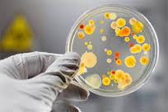
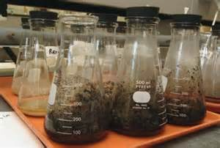
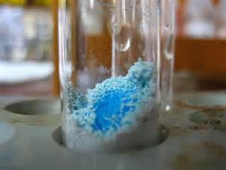
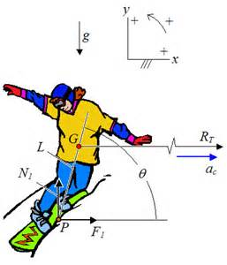
Taking an investigation on a tangent…
Discuss: Identify ‘core’ activities in each of the following VCE investigations, then suggest some ‘tangents’…

Slide 54
Discussion: Managing the new curriculum
What works now?
What will be different?
What are the main issues in schools? Solutions?

Slide 55
Logbook
Mandated across Units 1-4
Content may include:
experimental results, research notes, simulation outcomes, visual presentations, field trips, photographs and other images, demonstration summaries and database extract
May be electronic or paper copy: e-files/ notebook/ folder/ scrapbook/ section in folder/ duplicate book
Does not need to be ‘formally’ presented
Use for record, authentication and assessment purposes
Entries should be dated and in chronological order

Slide 56
Use of scientific posters
In Victorian schools - for example, Science Talent Search, and Year 7 to 10 presentations
Student entry into tertiary courses/ work experience/ part-time employment
In international schools - Singapore, USA – ‘science fairs’, competitions
At tertiary institutions - research presentations
At professional science conferences – trend towards minimal keynotes and rest being poster presentations, including an oral component – focus on science communication (concise)

Slide 57
Scientific poster
Section
Title
Introduction
Methodology
Results
Discussion
Conclusion
Acknowledgments and references

Slide 58
VCAA poster template

Slide 59
Scientific poster templates
A number of scientific poster templates are available free-of-charge on the internet. Some include handy tips.
http://colinpurrington.com/tips/poster-design
A site that offers multiple formats is at: http://www.posterpresentations.com/html/free_poster_templates.html

Slide 60
Poster authentication strategies
Adopt and/or adapt current authentication strategies for tasks requiring extended experiments and/or practical activity reports
Mark poster sections progressively
Use specific questions about science investigation processes as part of the poster development under test conditions
Logbook with dated entries should correlate to student work on poster
Observed practical procedures in class
Question students about content in specific parts of their poster

Slide 61
Poster logistics
No drafts
In Units 1 and 2, a scientific poster may be based on research (library), bioinfomatics exercise or primary research
In Unit 3 or 4, or across Units 3 and 4, the poster:
must involve collection of primary data
must include seven sections of poster template, with acknowledgment of level of guidance
may be an extension of a common experiment or fieldwork exercise
may be generated by students based on their own research and subject to authentication (use of photos/video…noted in logbook)
may be undertaken as a class with students contributing to design
may be assessed in stages (if modification required, original marks hold)
marks will be moderated against the examination – class rank order important

Slide 62
Units 3 and 4 Assessment - internal
Unit | Outcome | % study score | Unit % study score | VASS entry marks
3 | 1 | 8 | 16 | 50
 | 2 | 8 |  | 50
4 | 1 | 8 | 24 | 30
 | 2 | 8 |  | 30
 | *3 (poster) | 8 |  | 30
*Unit 4 Outcome 3 may be undertaken in either Unit 3 or Unit 4, or across both Units 3 and 4

Slide 63
Science faculty experimental investigation planner
Lab managers and science leaders should work together to plan investigations across all VCE sciences for a calendar year so that neither human nor physical resources are exhausted
Units 1 and 2 can be taught in any order; Units 3 and 4 must be taught as a sequence

Slide 64
Sample experimental investigation planner
VCE Science | Unit | Jan | Feb | Mar | Apr | May | Jun | Jul | Aug | Sep | Oct | Nov | Dec
Biology | 1
 | 2
 | 3&4
Chemistry | 1
 | 2
 | 3&4
Enviro Science | 1
 | 2
 | 3&4
Physics | 1 |  | part | part | part
 | 2
 | 3&4
Psychology | 1
 | 2
 | 3&4
Colour coding | No labs | Experimental investigation | Research investigation | Physics options

Slide 65
VCAA contact
Maria James
Curriculum Manager, Science
Email: james.maria.m@edumail.vic.gov.au
Telephone: 9032 1722

